Slide 1



UCI AIR QUALITY UNIVARIATE LINEAR REGRESSION MODELLING
IRONHACK DAFT AUG22 “Data Analytics” Midterm Project Presentation
Team Member: Rodrigo Franco, Gunnar David
CONFIDENTIAL

Slide 2

UCI AIR QUALITY UNIVARIATE AND MULTIVARIATE STUDY
IRONHACK DAFT AUG22 “Data Analytics” Midterm Project Presentation
Team Member: Rodrigo Franco, Gunnar David
CONFIDENTIAL

Slide 3
General guidelines for the presentations:
7 min presentation + 5 min Q&A (+1 min for the Elisabeth, Rodrigo, Paul and Esra)
Introduce the research/business question/hypothesis you're trying to answer/test and the type and the objective of the study (descriptive, predictive, BI...);
High-level description of the data you have in hand, supported by meaningful plots/tables (size, quality of the data, how's it distributed, etc.);
Insights/Findings:
show only the charts that make sense and have interesting/unusual/meaningful patterns;
every chart/plot need a title and legend;
Data processing pipeline;
describe the features used for the modeling and the algorithms used ( Modeling project);
Outcome & Results (e. g. conclusions, model interpretation, the answer to the research question/hypotheses, etc.);
Outlook (e. g. limitations, next steps, learnings, etc.)
Remember: great presentation = content + design + delivery.
!

Slide 4


Meet the UCI AQ Team!
Rodrigo Franco
Home Country: Paraguay
Post-Ironhack Industry: Consulting
Programming Language: Python
Gunnar David
Home Country: Germany
Post-Ironhack Industry: Consulting
Programming Language: Python, R, JavaScript, HTML5 & CSS3

Slide 5

Friday, the 09th of September Time: 12:15 – 12:30 CEST [Click] Zoom Call

Slide 6

Green Belt Tollgate Review
Define Phase

Slide 7
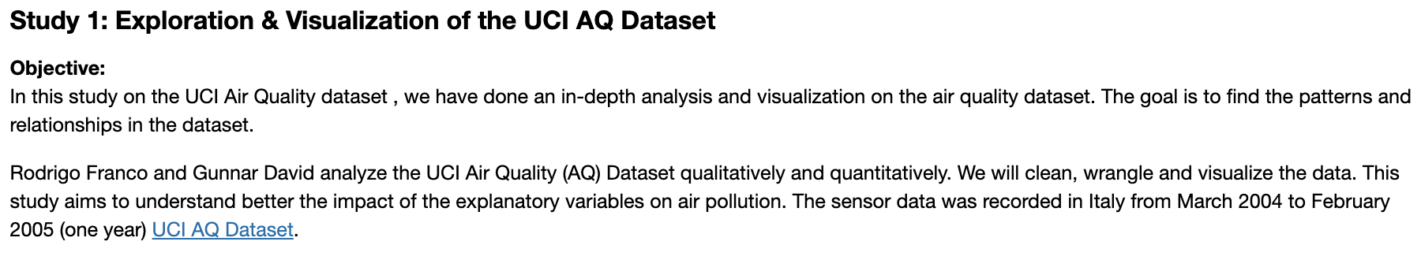
Development Specification
Full DSD click here

Slide 8
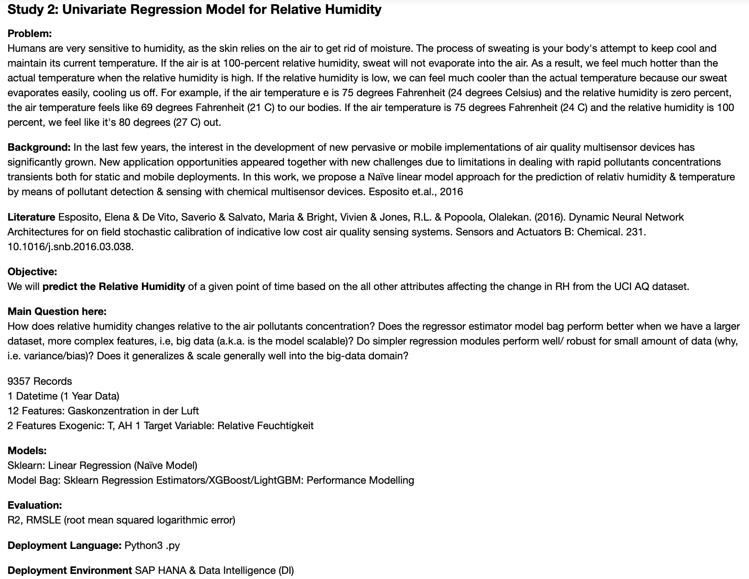
Development Specification Cont`
Full DSD click here

Slide 9
Contents
Project Overview
Objective
Data preview
Analytics Roadmap
Analysis process
Key Findings
Regression models
Output
Visualization
Observations
Recommendations

Slide 10

Project Overview

Slide 11




Overview BIG Questions
How does relative humidity (RH) changes statistically and linearly with the air pollutant concentration?
What important factors impact RH and how?
How would the RH linear regression model scale with AQ big data? Is the RH linear regression model sufficient for the objective?
What is the optimal predictive model for RH from AQ data?

Slide 12
Introduction to the Research
UCI Air Quality Study
Define Phase
Study 1: Exploration & Visualization of the UCI AQ Dataset
Objective:
In this study on the UCI Air Quality dataset , we have done an in-depth analysis and visualization on the air quality dataset. The goal is to find the patterns and relationships in the dataset.
Rodrigo Franco and Gunnar David analyze the UCI Air Quality (AQ) Dataset qualitatively and quantitatively. We will clean, wrangle and visualize the data. This study aims to understand better the impact of the explanatory variables on air pollution. The sensor data was recorded in Italy from March 2004 to February 2005 (one year) [UCI AQ Dataset](https://archive.ics.uci.edu/ml/datasets/air+quality).
Summary report: UCI AQ Data Analysis Report

Slide 13
Introduction to the Research
UCI Air Quality Study
Define Phase
Study 2: Univariate Regression Model for Relative Humidity
Problem:
Humans are very sensitive to humidity, as the skin relies on the air to get rid of moisture. The process of sweating is your body's attempt to keep cool and maintain its current temperature. If the air is at 100-percent relative humidity, sweat will not evaporate into the air. As a result, we feel much hotter than the actual temperature when the relative humidity is high. If the relative humidity is low, we can feel much cooler than the actual temperature because our sweat evaporates easily, cooling us off. For example, if the air temperature e is 75 degrees Fahrenheit (24 degrees Celsius) and the relative humidity is zero percent, the air temperature feels like 69 degrees Fahrenheit (21 C) to our bodies. If the air temperature is 75 degrees Fahrenheit (24 C) and the relative humidity is 100 percent, we feel like it's 80 degrees (27 C) out.
Background:
In the last few years, the interest in the development of new pervasive or mobile implementations of air quality multisensor devices has significantly grown. New application opportunities appeared together with new challenges due to limitations in dealing with rapid pollutants concentrations transients both for static and mobile deployments. In this work, we propose a Naïve linear model approach for the prediction of relativ humidity & temperature by means of pollutant detection & sensing with chemical multisensor devices. Esposito et.al., 2016 ^{[1]}
Main Question here:
How does relative humidity changes relative to the air pollutants concentration?
Does the regressor estimator model bag perform better when we have a larger dataset, more complex features, i.e, big data (a.k.a. is the model scalable)?
Do simpler regression modules perform well/ robust for small amount of data (why, i.e. variance/bias)? Does it generalizes & scale generally well into the big-data domain?
^{[1]}Esposito, Elena & De Vito, Saverio & Salvato, Maria & Bright, Vivien & Jones, R.L. & Popoola, Olalekan. (2016). Dynamic Neural Network Architectures for on field stochastic calibration of indicative low cost air quality sensing systems. Sensors and Actuators B: Chemical. 231. 10.1016/j.snb.2016.03.038.

Slide 14
Smart Objective
Slide Reference
Usage: Mandatory
Description: Communication Plan describing who you will be communicating to, what you will be communicating to them, when you will do it (frequency), how you will do it (in-person, email, phone, etc), and who will do the communicating.
Instructions: Consider the key stakeholders of your project who need to be informed of actions. How often should they be updated to keep informed of your decisions and results? Are there any stakeholders who will be significantly impacted by your project that need to stay involved throughout?
UCI Air Quality Study
Define Phase
We will predict the Relative Humidity of a given point of time based on the all other attributes affecting the change in RH from the UCI AQ dataset, improving Naïve linear regression baseline performance by 20% using ensemble models.
Also note that perhaps more than one machine learning model is required if results from a single model on all Relative Humidity is not effective.

Slide 15
Our analysis focuses on all 5 measures and 13 dimensions derived from UCI AQ df, combined with 3 exogenous factors
Averaged concentrations& sensor responses
(hourly entries)
Y-M-D-HH:MM:SS 2004-03-10 18:00:00 2005-04-04 14:00:00
1 Meaningless Variables
NMHC_GT 90.23% NaN
Year Month Hour 4 Seasons, Month Name, Hour
13 Contributing Dimensions
Concentration Detection
(Ground Truth)
Responds
Detection
(Nominally Targeted)
Exogenous Factors:
T, RH, AH
9,357 Rows
3 Segments
15 Columns
Non-Methane Hydrocarbons, Benzene, CO, NOx, O3
10 Pollutants
3 Categories
PT08.S1(CO
3 Exogenous Factors:
Temp
RH
AH
PT08.S2(NMHC
Sensor Responds (Proxy to Gases
which are measured by their concentration
5 Measures
T08.S3(NOx
PT08.S4(NO2)
1 Temporal Factors:
Datetime
PT08.S5(O3)

Slide 16
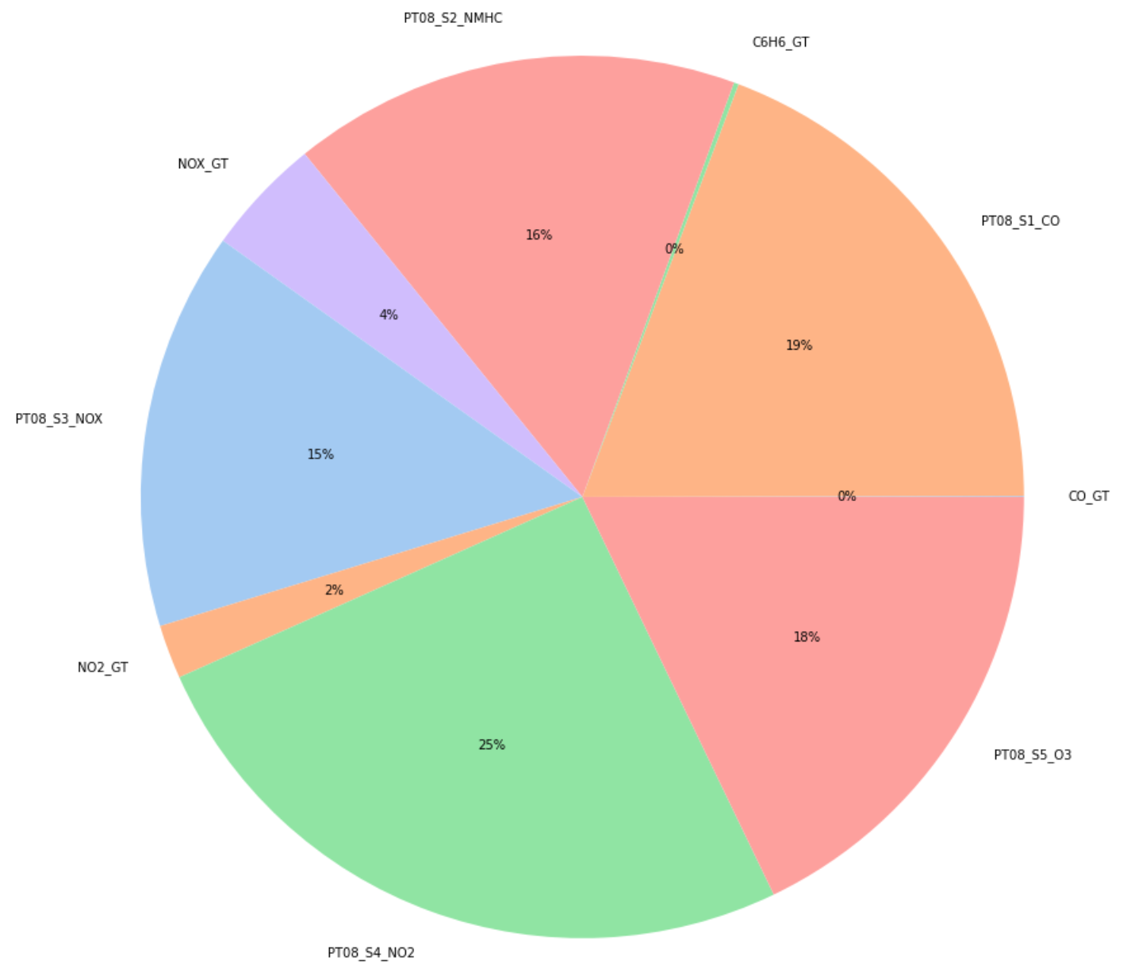

Share of AQ Pollutants
Slide Reference
Usage: Recommended (although depending on the project, it may not be feasible to conduct a detailed study)
Description: Overview of your MSA findings.
Instructions: Describe the results and findings of your MSA. Show the MiniTab graphical output and discuss key highlights. Populate at the bottom of the page in a clear manner whether the MSA proves or disproves you have valid data.
UCI Air Quality Study 1
Measure Phase
Key Findings:
Each slice of the pie chart represents the mean of concentration of a gas throughout the year. Concentration of tungsten oxide (PTO8_S4_NO2) is maximum.
Key Need:
Recently, new sensing technologies and systems for achieving a truly pervasive air quality (AQ) monitoring capability in cities are being developed. The primary driver is actually the current coarse grained and sparse AQ measuring mesh that is based on costly and cumbersome conventional analyzers.
→ These are challenged by the need for obtaining a detailed and representative map of the true concentrations of pollutants in the city. E. Esposito et.al., 2016
Upload Minitab File
32.3 K
Datetime Length: 2004-03-10 - 2005-04-04
Country: Italy
City: assumed Milan

Slide 17
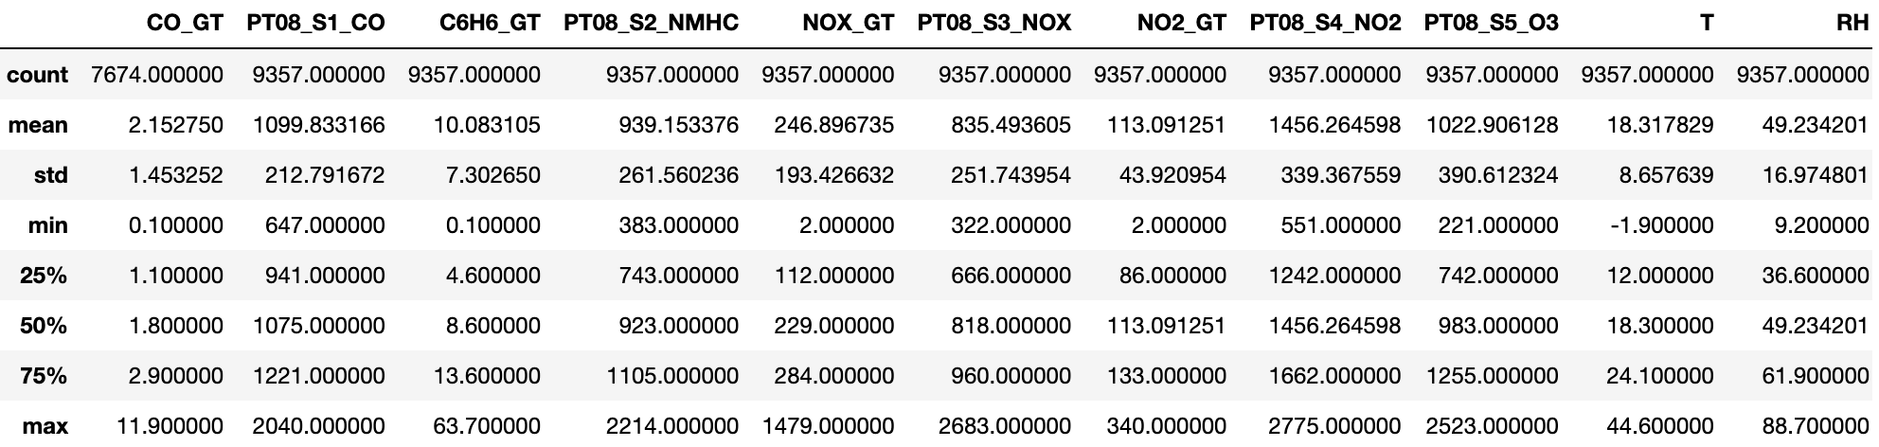
Stats of AQ Pollutants
Slide Reference
Usage: Recommended (although depending on the project, it may not be feasible to conduct a detailed study)
Description: Overview of your MSA findings.
Instructions: Describe the results and findings of your MSA. Show the MiniTab graphical output and discuss key highlights. Populate at the bottom of the page in a clear manner whether the MSA proves or disproves you have valid data.
UCI Air Quality Study 1
Measure Phase
Upload Minitab File

Slide 18
DOUBLE CHECK EDA & REGRESSION JUPYTER ALL INCLUDED?

Slide 19
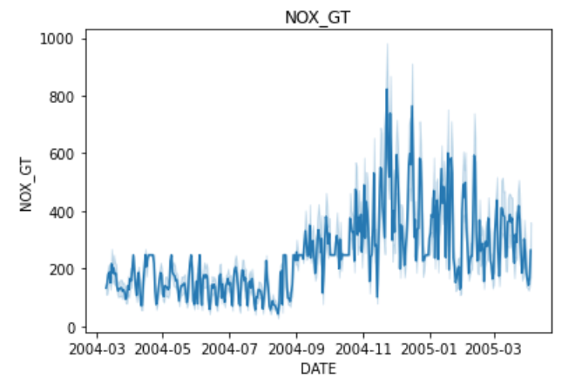
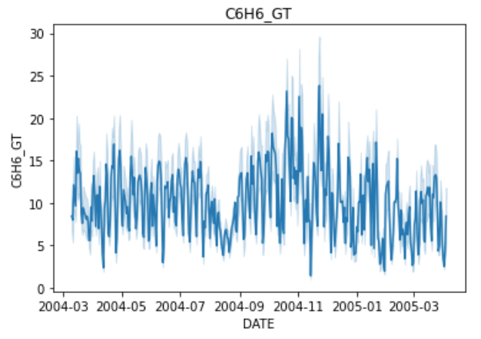
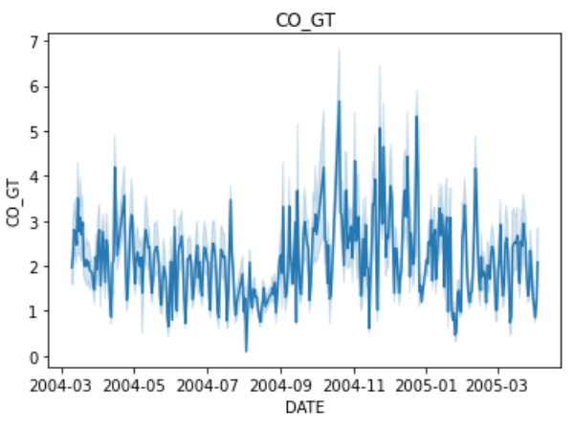
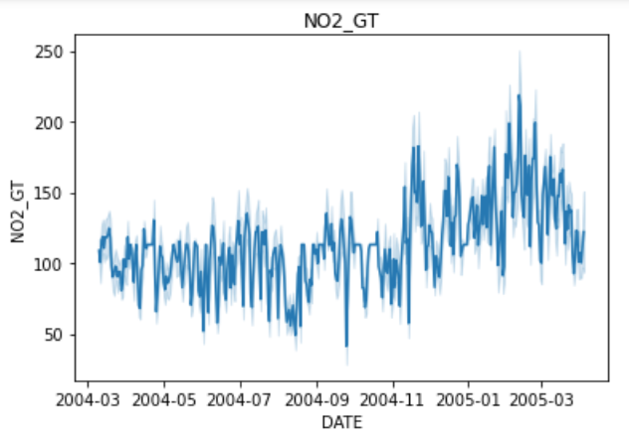
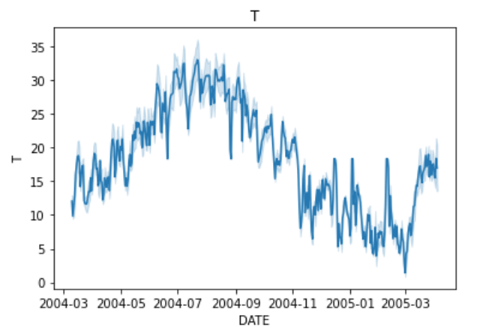
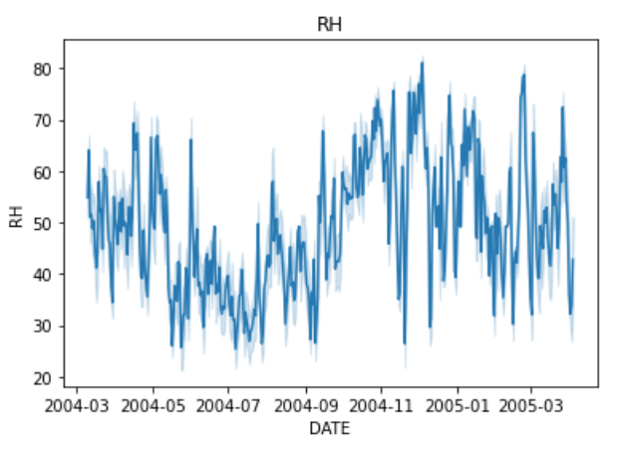
Reference

Slide 20
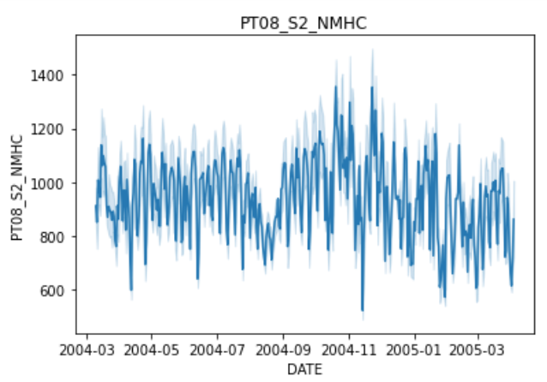
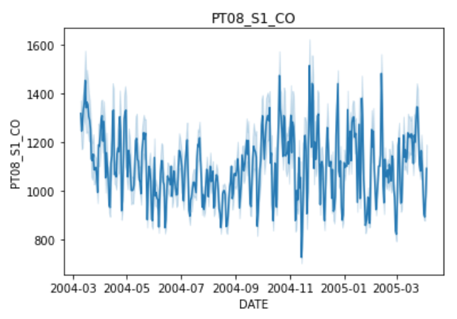
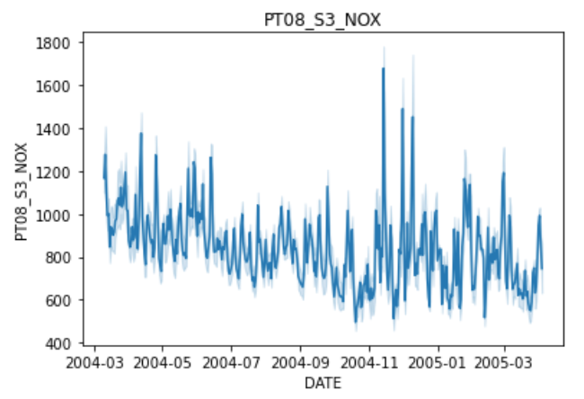
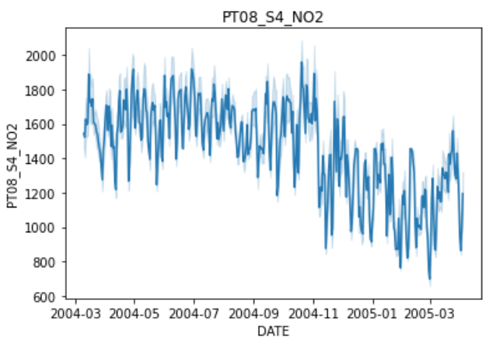
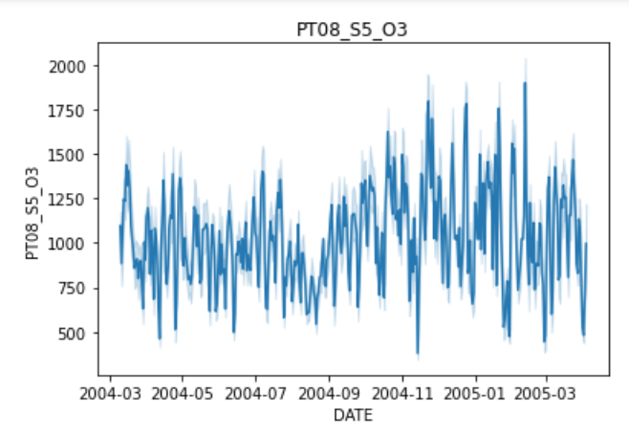
Sensors

Slide 21
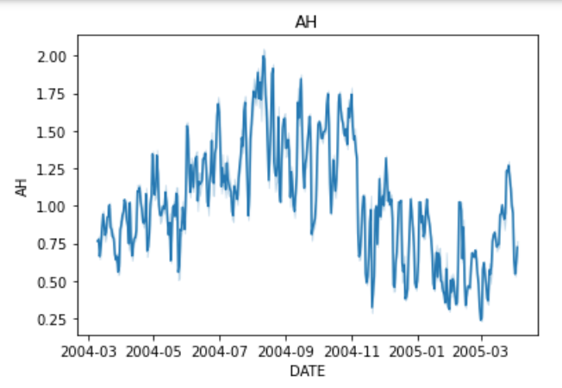
Exogenous

Slide 22
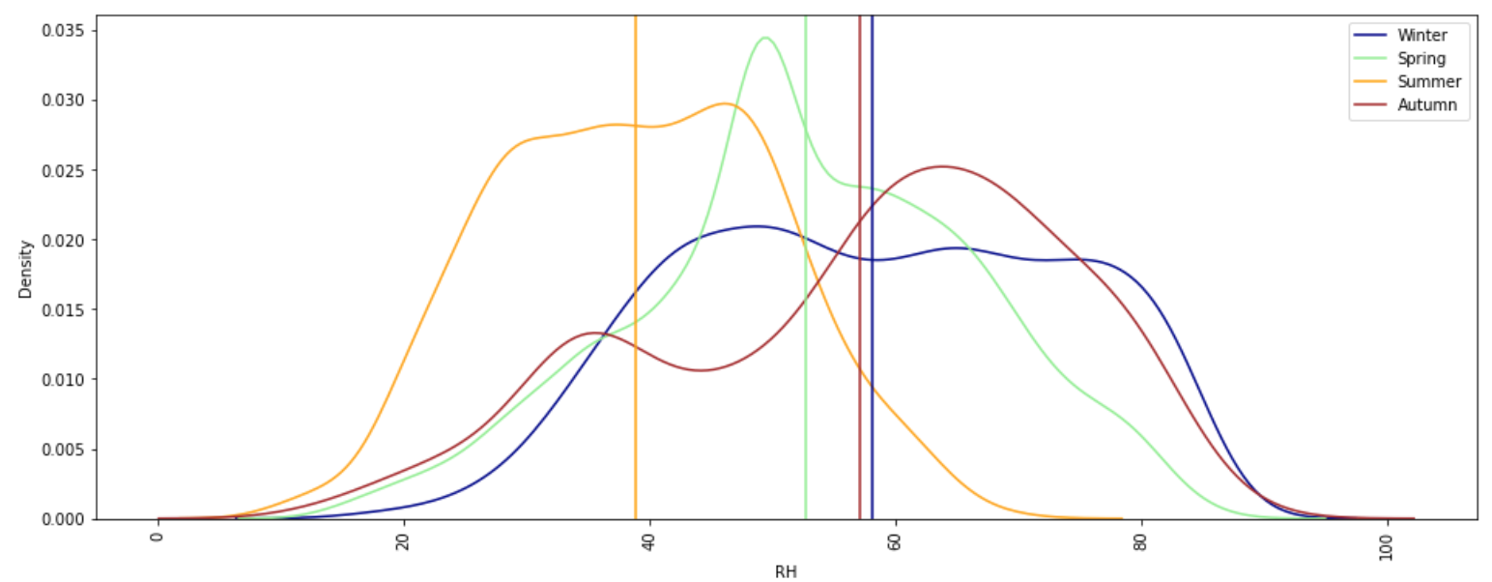
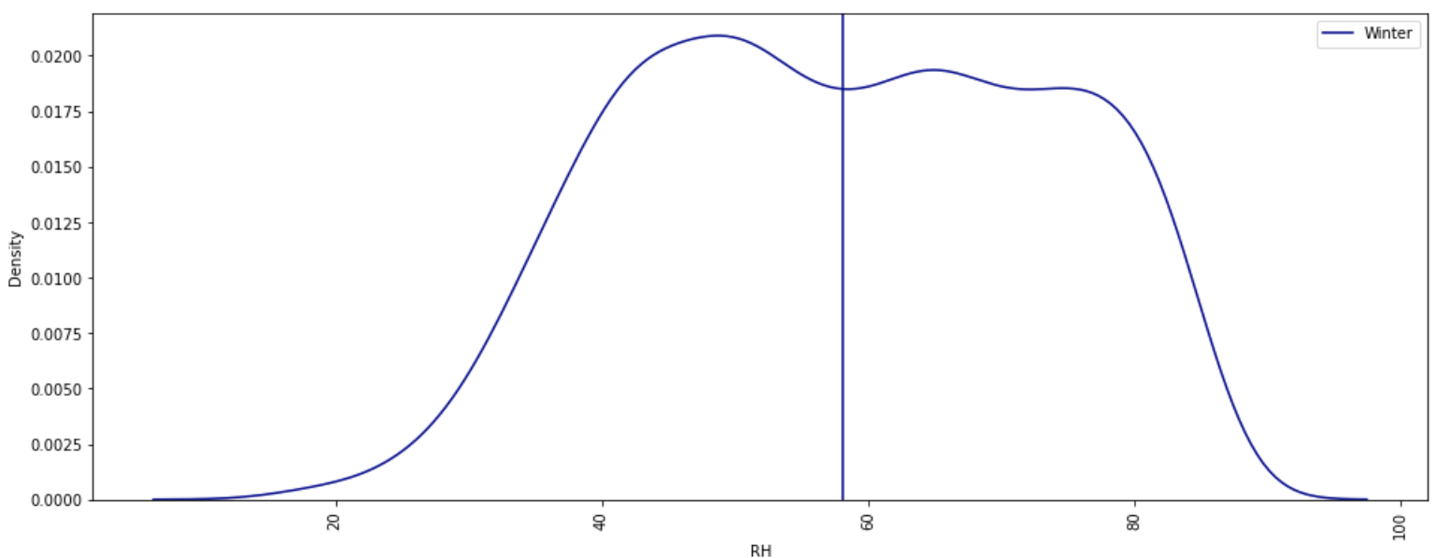
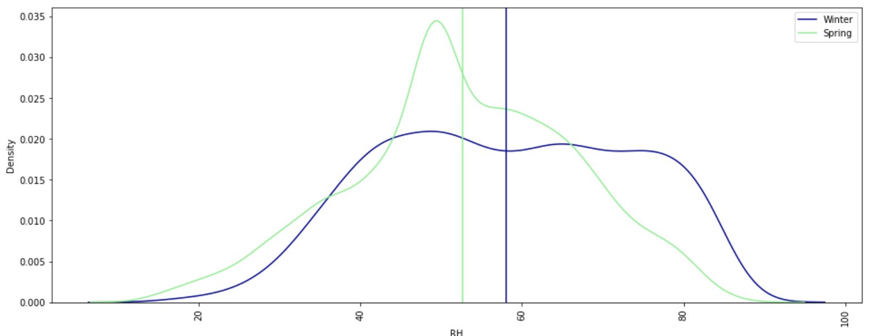
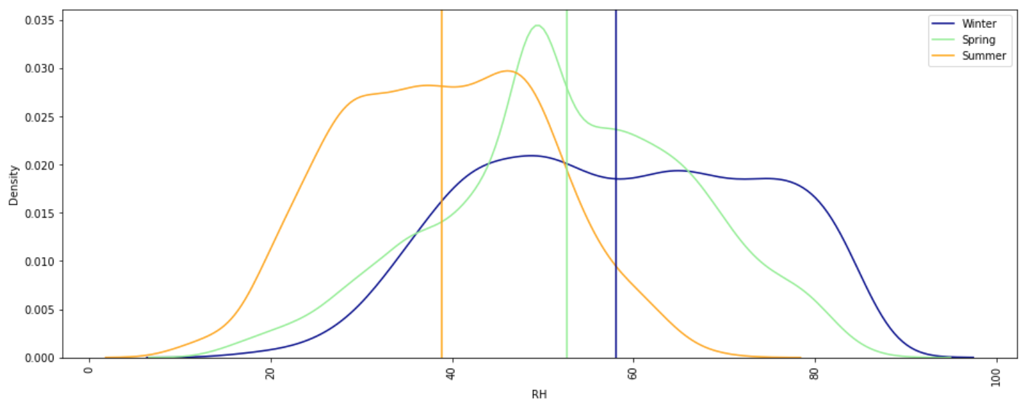

Slide 23
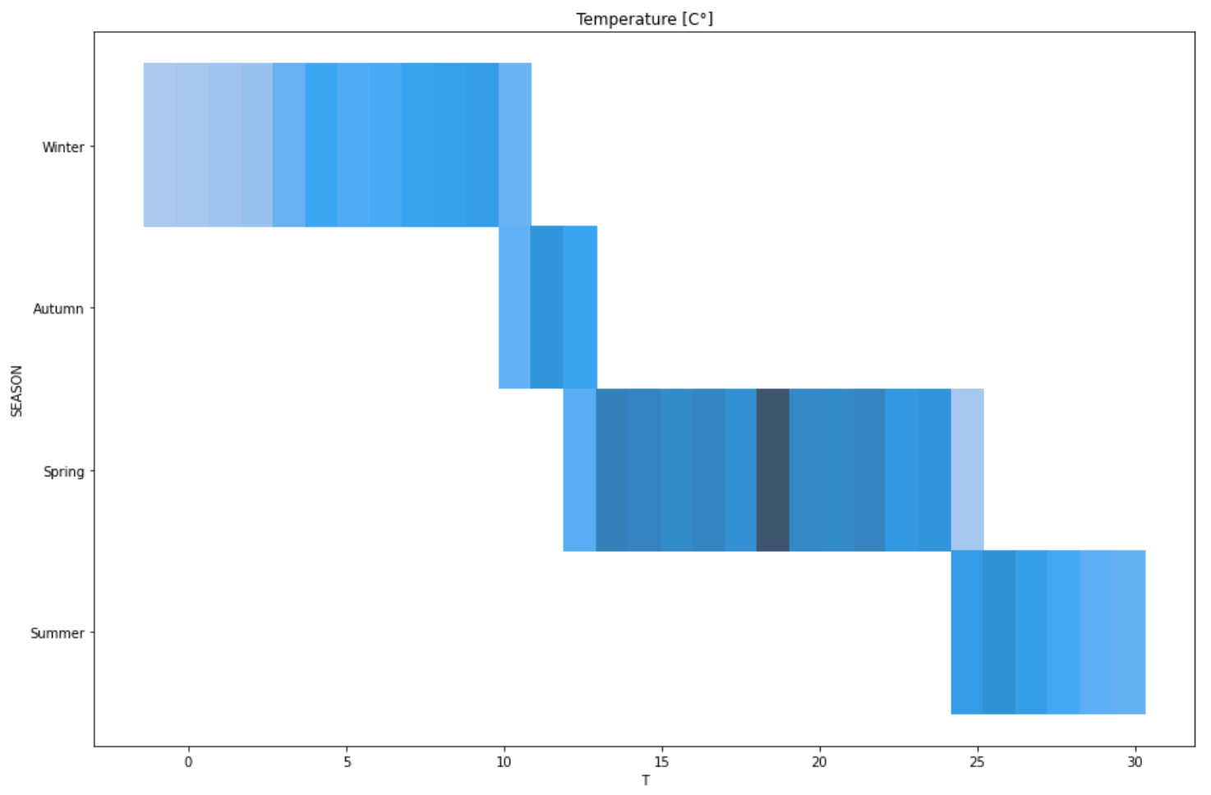
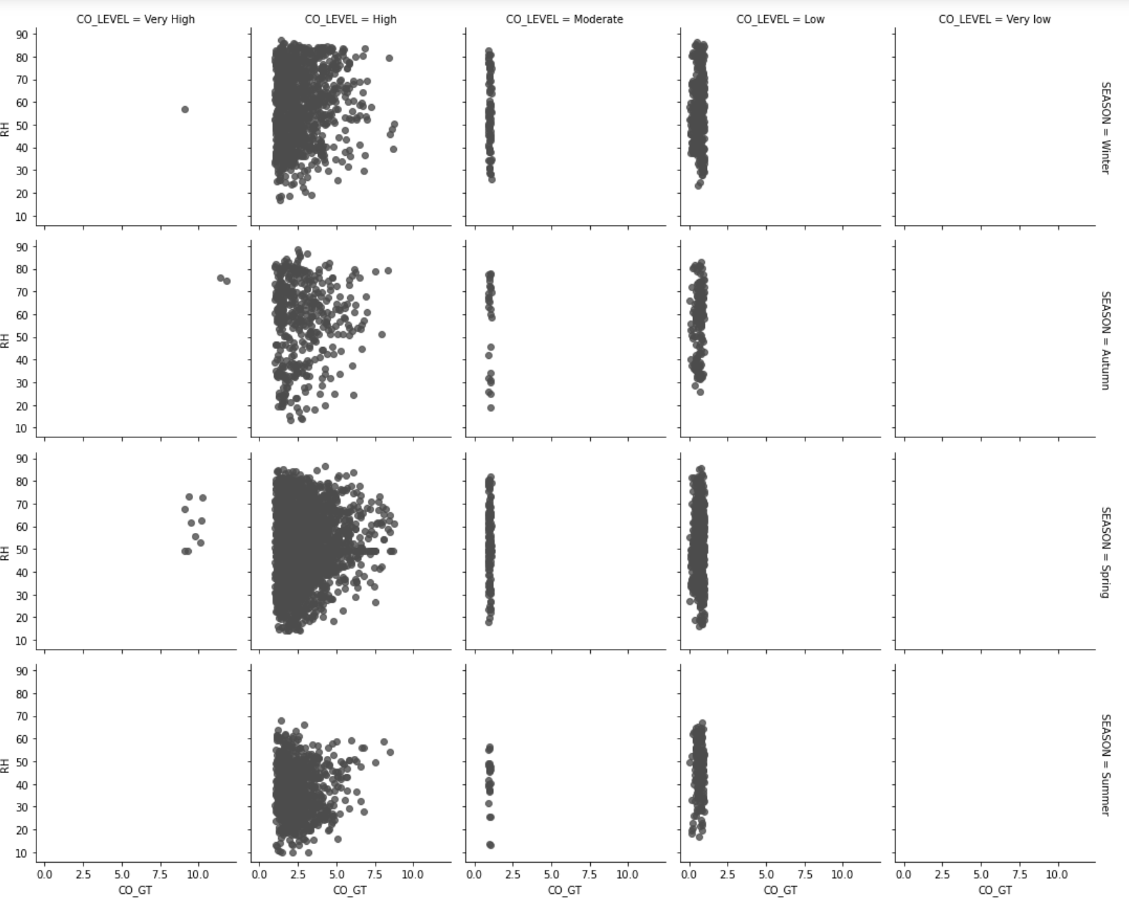

Slide 24
CHECK THE REPORT and ADD

Slide 25
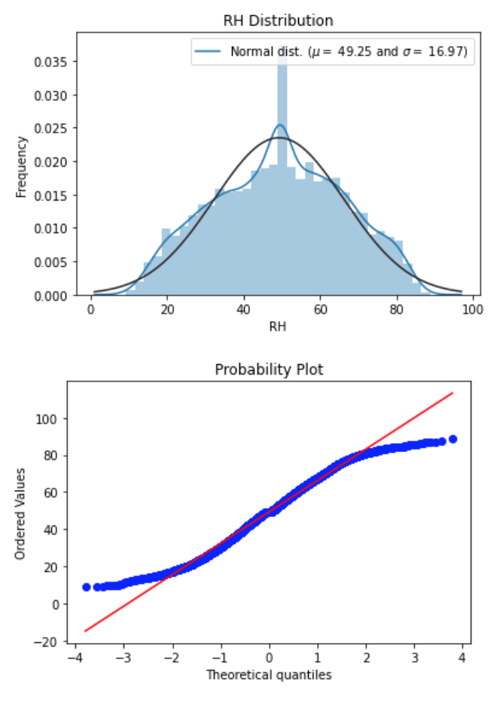
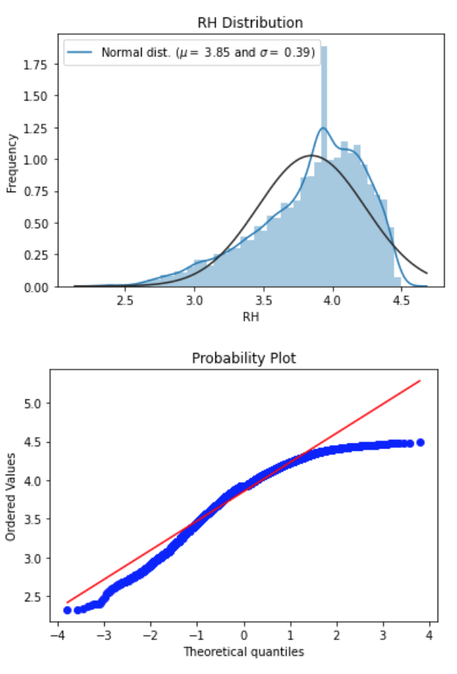
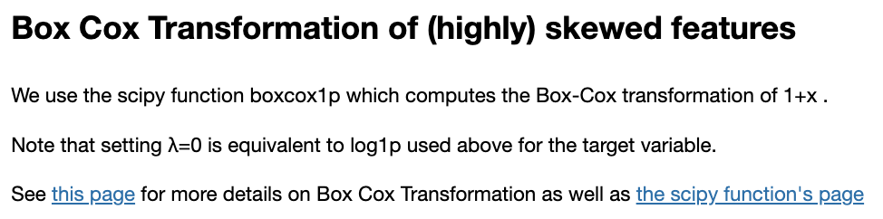

Slide 26
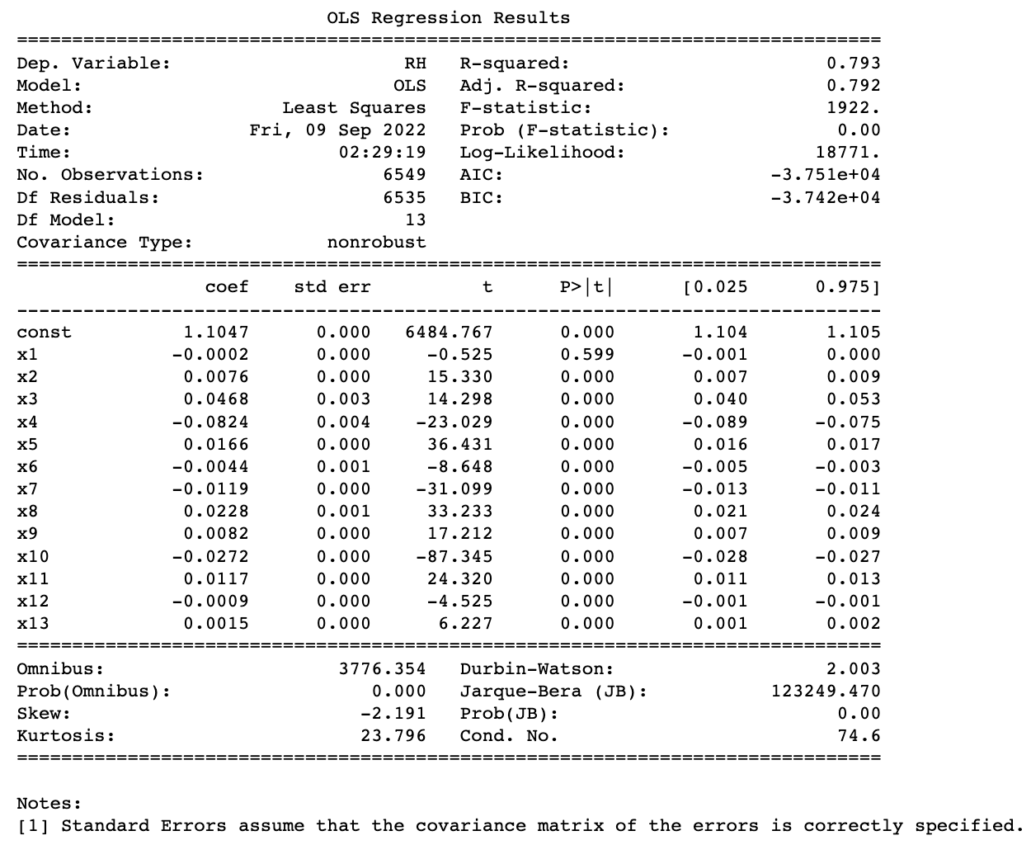
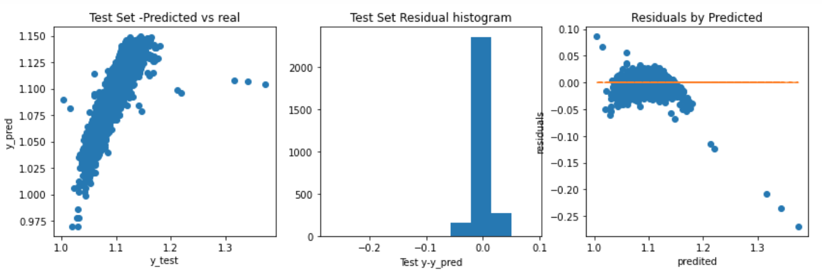
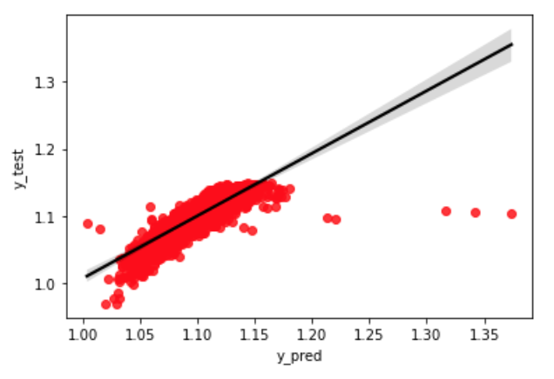
Linear Regression

Slide 27
LightGBM CHECK and GET figs Regression

Slide 28
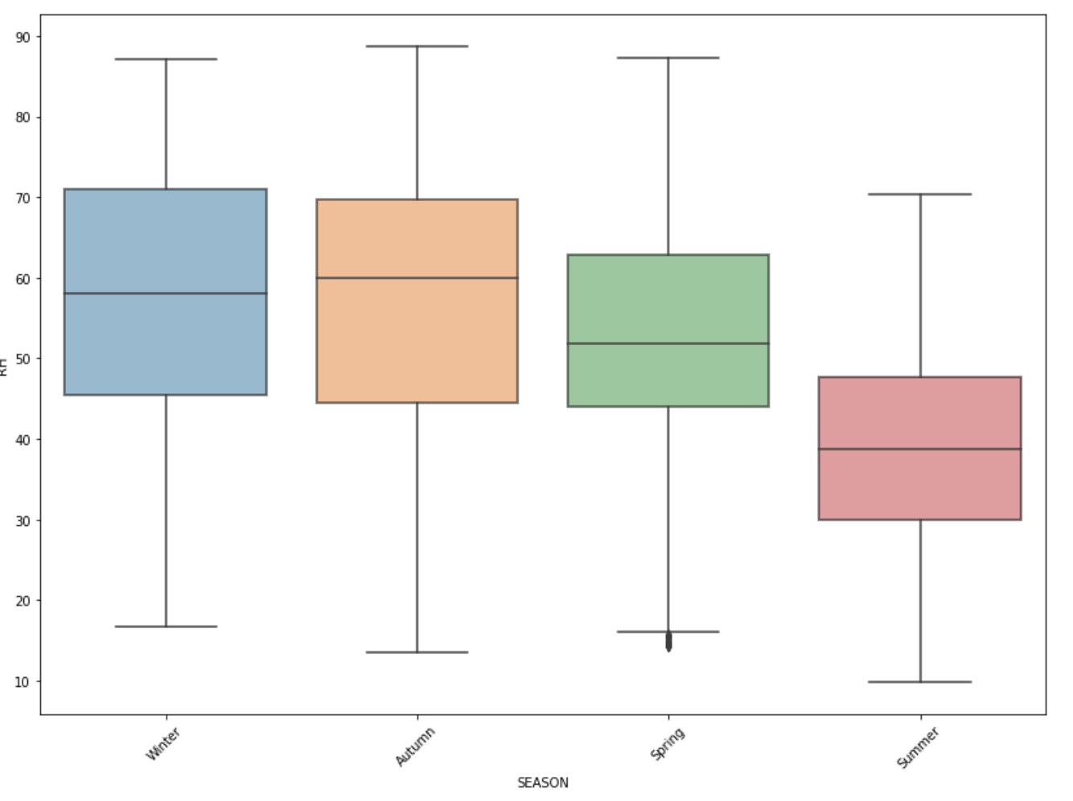
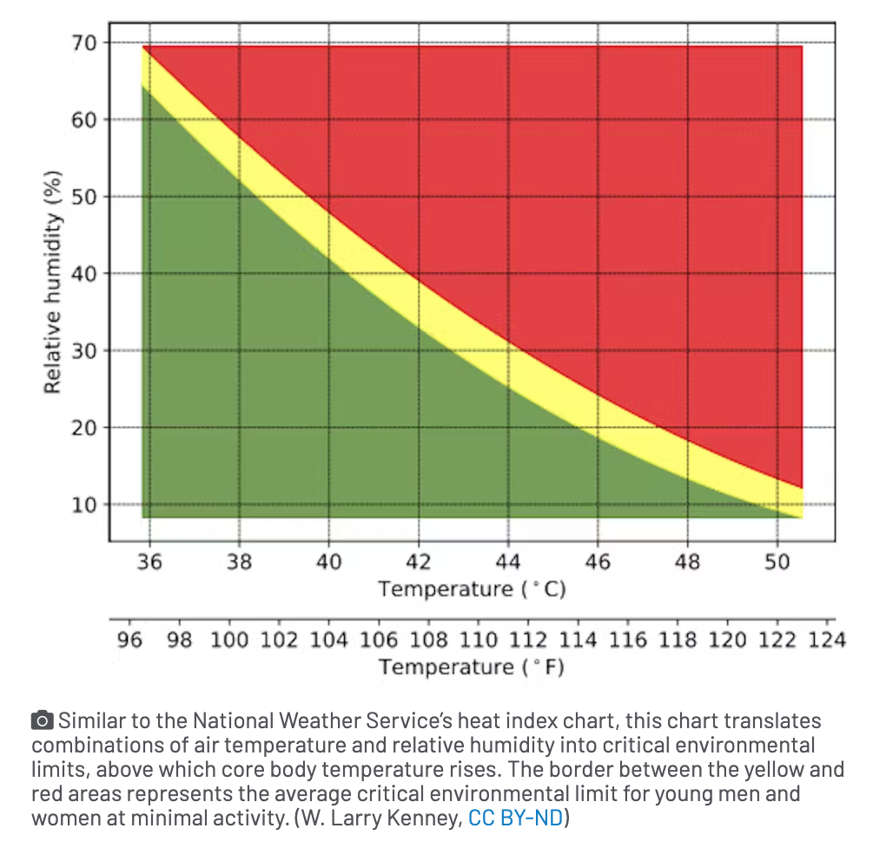
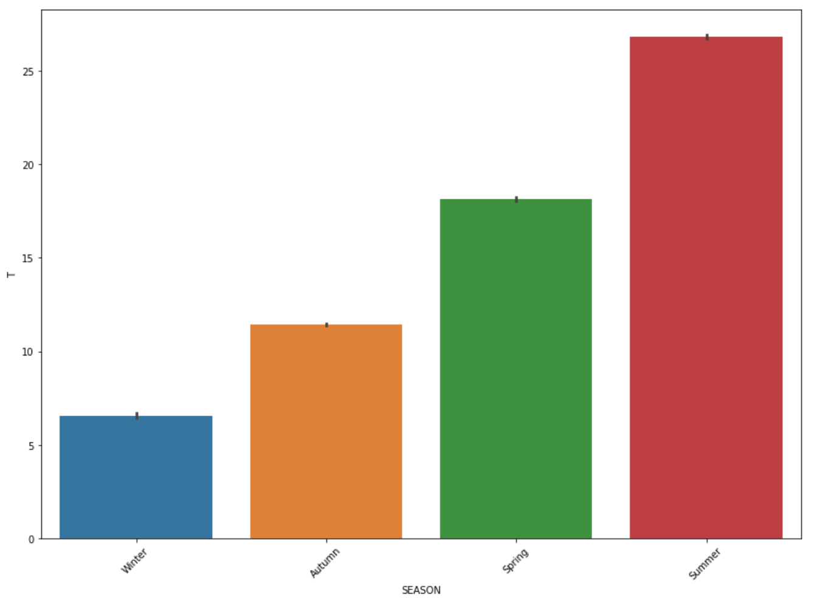

Slide 29
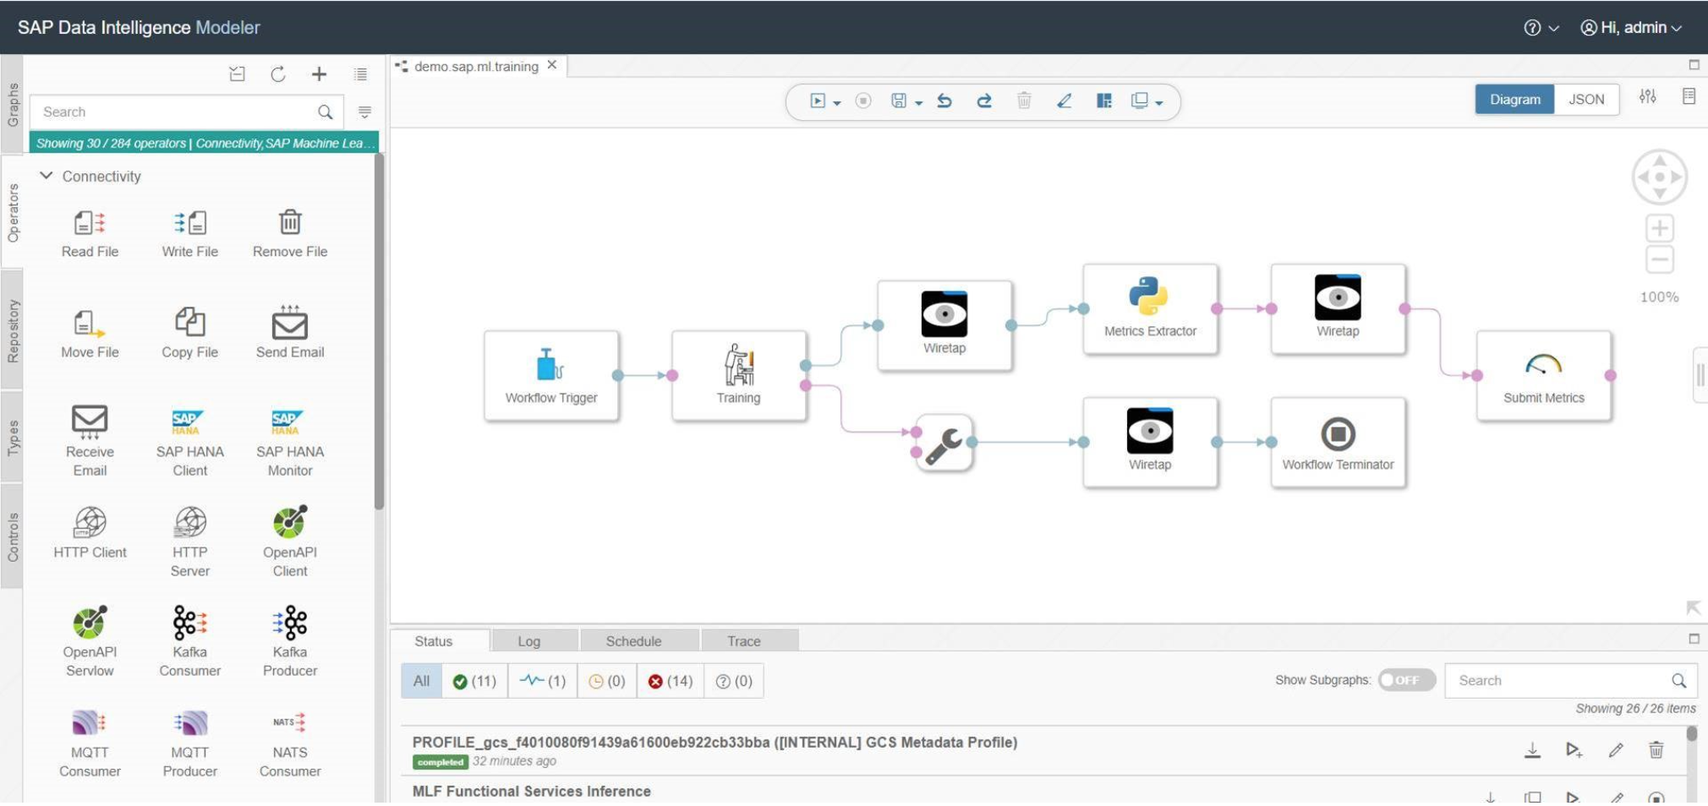

Slide 30
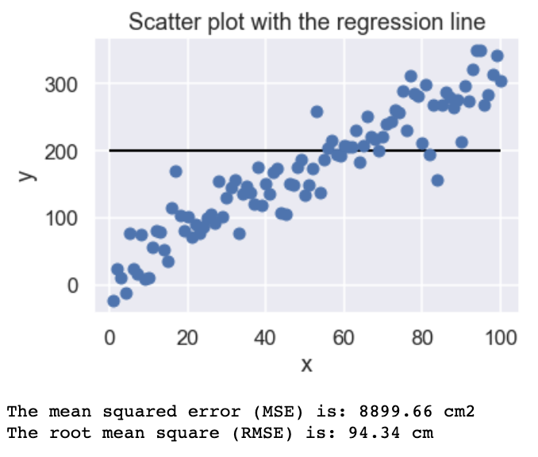
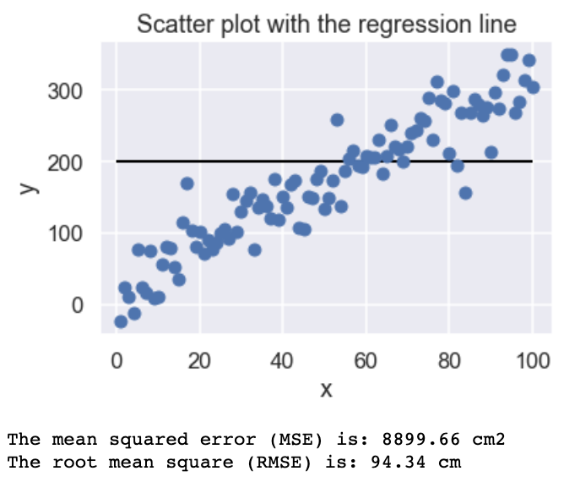
DOUBLE CHECK

Slide 31
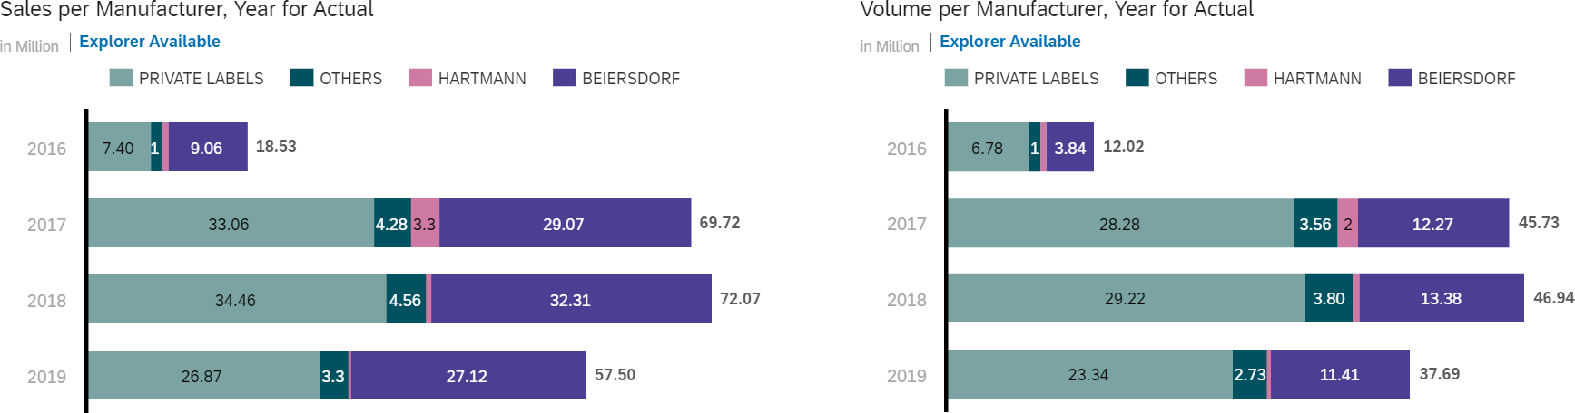
Beiersdorf and Private Labels are the main players in the German wound protection market
Beiersdorf products are more premium with higher price points.

Slide 32
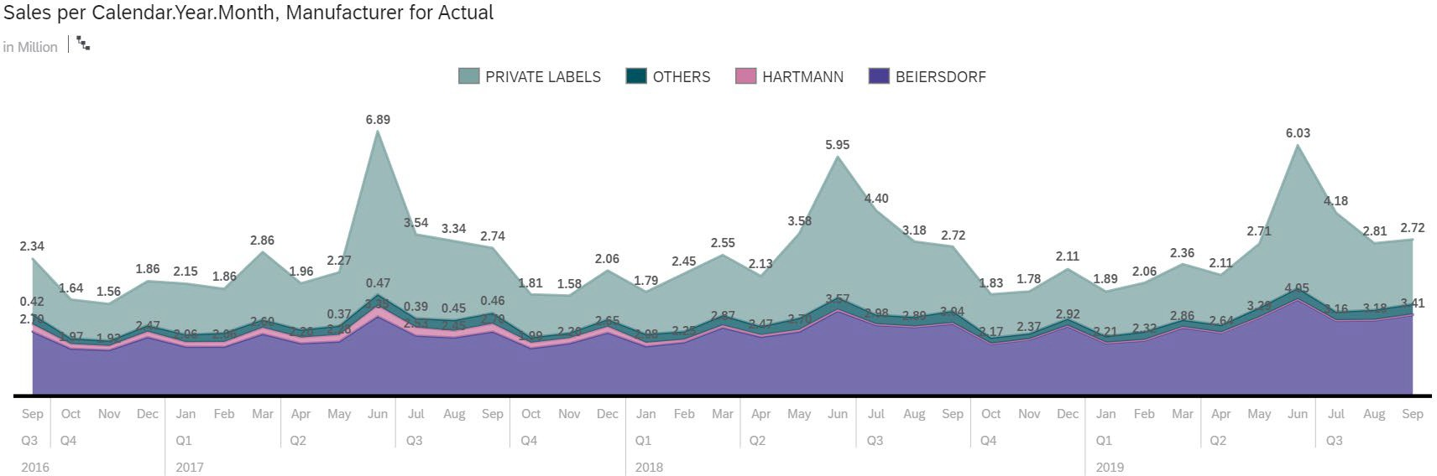
Sales appears to have seasonality across brands
June has the highest sales in all 3 years.

Slide 33
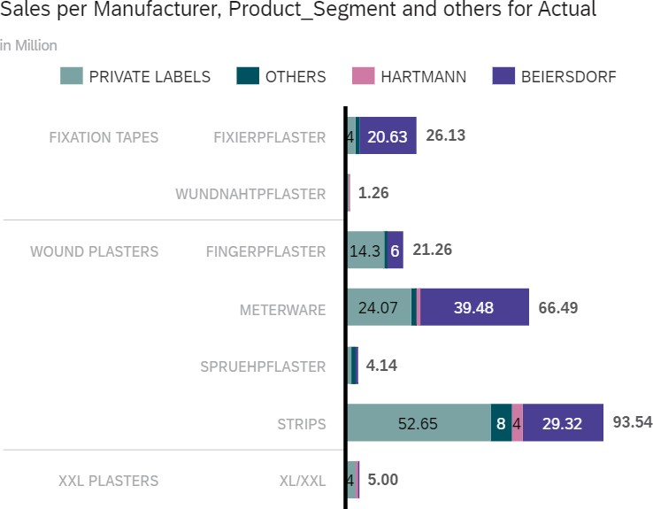
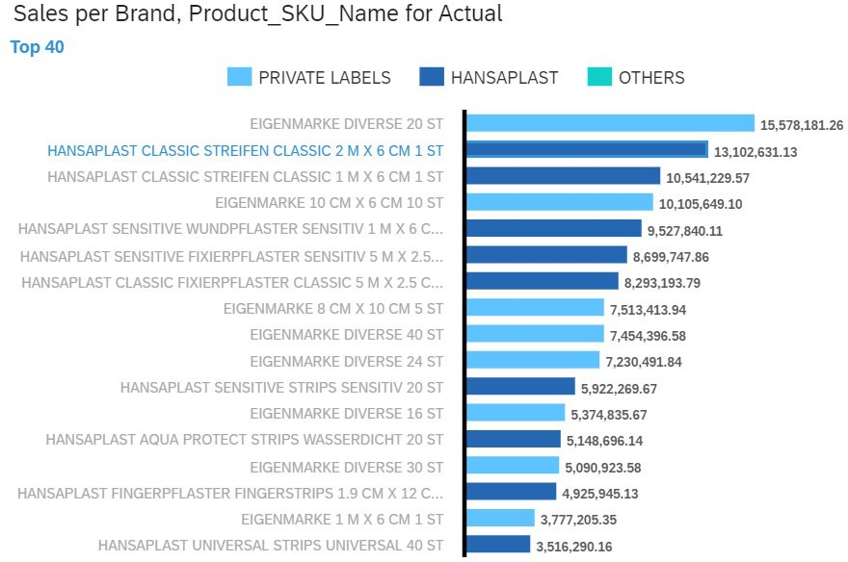
Top 40 products represented 80% of the total sales
Strips and Meterware are the top 2 sub-segments for sales.

Slide 34

Analytics Roadmap

Slide 35
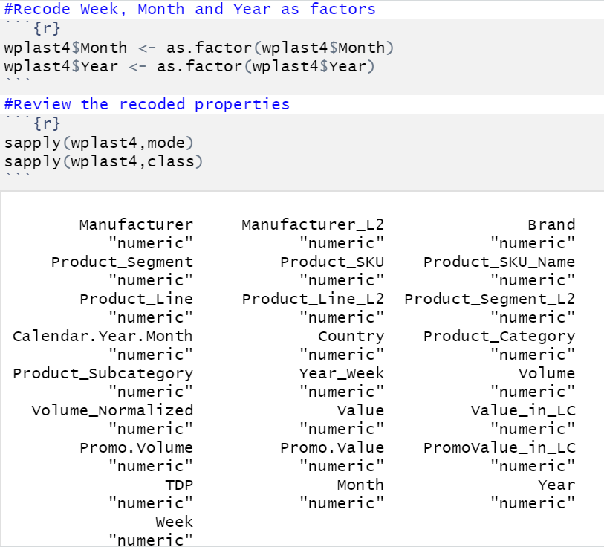
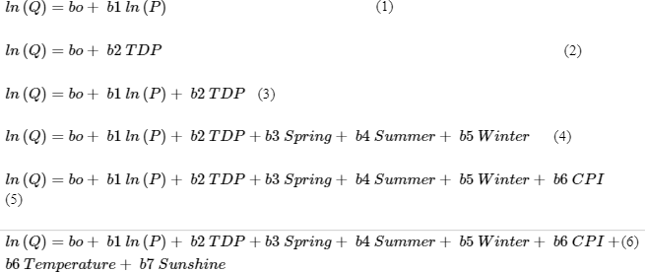
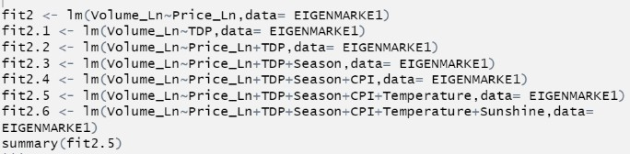
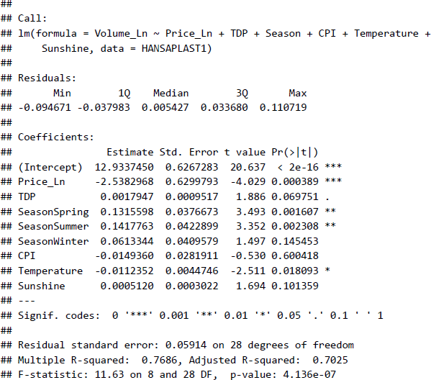
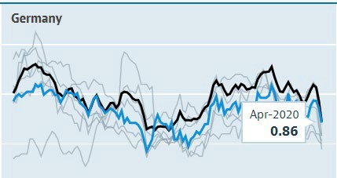
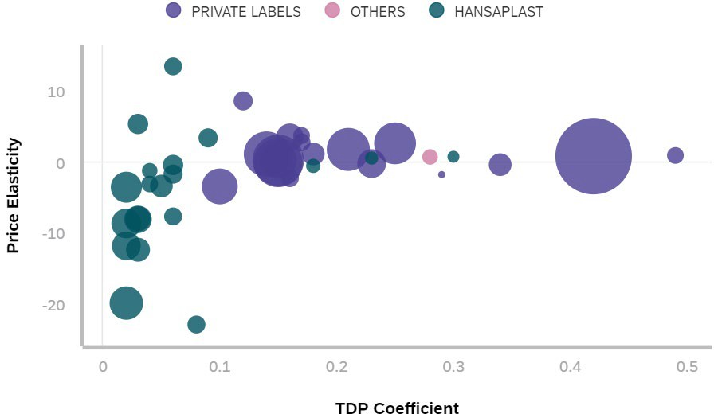
We used R cloud for analysis and SAC for visualization
1
Data cleaning
2
Data preparation
3
Modeling in R
4
Visualization
Remove redundant columns
Consolidate weekly data
Coerce data types
Create new variables
Log transformation
Combine macro data
Create subsets
Plot scatter charts
Run Regressions
Regression outputs
Aggregation charts
Observation & analysis
Combo Adj R2 HANSAPLAST AQUA PROTECT STRIPS 20 ST 87.1% HANSAPLAST SENSITIVE STRIPS 20 ST 84.8% HANSAPLAST UNIVERSAL STRIPS 40 ST 83.3% HANSAPLAST DRK MIX PACK DIVERSE 20 ST 89.6% HANSAPLAST WATERPROOF 16 ST 72.7% HANSAPLAST STREIFEN ELASTIC 20 ST 69.8% HANSAPLAST SILICONE SOFT DIVERSE 8 ST 61.9% HANSAPLAST KIDS FROZEN DIVERSE 16 ST 71.1% EIGENMARKE DIVERSE 20 ST 51.3% EIGENMARKE 8 CM X 10 CM 5 ST 56.0% EIGENMARKE DIVERSE 40 ST 36.4% EIGENMARKE DIVERSE 24 ST 64.8% EIGENMARKE DIVERSE 16 ST 74.1% EIGENMARKE WUNDSCHNELLVERBAENDE 67.3% EIGENMARKE DIVERSE 30 ST 16.7% EIGENMARKE DIVERSE 10 ST 73.1% FIGO ERSTE HILFE DIVERSE 36 ST 76.0% | Price_Ln |  | TDP |  | Spring |  | Summer |  | Winter |  | CPI |  | Temperature |  | Sunshine
 | Coeff Sign |  | Coeff Sign |  | Coeff Sign |  | Coeff Sign |  | Coeff Sign |  | Coeff Sign |  | Coeff Sign |  | Coeff Sign
 | (6.76) (4.72) 0.11 (8.04) (6.33) (1.64) (21.68) (0.78) (0.16) 1.40 0.33 (0.68) 3.51 (4.36) (0.31) (0.43) 1.19 | Yes Yes | 0.031 0.027 0.060 0.052 0.050 0.050 0.063 0.198 0.146 0.144 0.208 0.188 0.168 0.086 0.228 0.336 0.277 | Yes | (0.010) (0.016) 0.023 0.132 0.041 0.150 0.281 0.434 (0.083) 0.204 0.096 | No | 0.369 0.299 0.345 0.334 0.413 0.376 0.615 0.589 0.079 0.536 0.369 (0.168) 0.592 (0.992) 0.064 0.171 0.988 | Yes | 0.044 (0.021) (0.005) 0.144 (0.018) 0.019 0.133 0.381 0.065 (0.278) 0.058 0.157 (0.445) | No | 0.037 0.029 (0.006) 0.156 0.173 0.221 0.078 0.380 0.118 (0.102) (0.350) 0.481 0.460 (0.071) 0.032 (0.319) (0.281) | No | (0.002) (0.007) (0.005) 0.006 0.001 0.002 (0.010) (0.051) 0.012 (0.102) 0.026 0.120 (0.034) 0.267 (0.004) (0.011) (0.067) | No | 0.001 0.001 0.001 0.001 0.000 0.000 0.002 0.002 0.000 0.004 (0.002) 0.003 0.002 0.002 (0.000) 0.003 0.004 | Yes
 |  |  |  | Yes |  | No |  | Yes |  | No |  | No |  | No |  | Yes
 |  | No |  | Yes |  | No |  | Yes |  | No |  | No |  | No |  | Yes
 |  | Yes Yes |  | Yes |  | Yes |  | Yes |  | No |  | Yes |  | No |  | Yes
 |  |  |  | Yes |  | No |  | Yes |  | No |  | Yes |  | No |  | No
 |  | No |  | Yes |  | Yes |  | Yes |  | No |  | Yes |  | No |  | No
 |  | Yes |  | Yes |  | No |  | Yes |  | No |  | No |  | No |  | No
 |  | Yes |  | Yes |  | Yes |  | Yes |  | Yes |  | Yes Yes |  | Yes |  | No
 |  | Yes |  | Yes |  | No |  | No |  | No |  |  |  | No |  | No
 |  | Yes |  | Yes |  | No |  | Yes Yes |  | No |  | No |  | Yes |  | Yes
 |  | Yes |  | Yes |  | No |  |  |  | No |  | Yes |  | No |  | No
 |  | No |  | Yes | - NA |  |  | No |  | No |  | No |  | No |  | No
 |  | Yes |  | Yes | (0.154) 1.497 0.086 (0.119) 0.395 | No |  | Yes Yes |  | Yes |  | Yes |  | No |  | No
 |  | Yes |  | Yes |  | Yes |  |  | - NA |  |  | No No |  | Yes |  | No
 |  | Yes |  | Yes |  | No No |  | No No | 0.076 0.071 (0.130) | No |  |  |  | No No |  | No
 |  | Yes |  | Yes |  |  |  |  |  | No |  | Yes Yes |  |  |  | Yes Yes
 |  | No |  | Yes |  | Yes |  | Yes |  | No |  |  |  | Yes

Slide 36
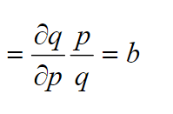
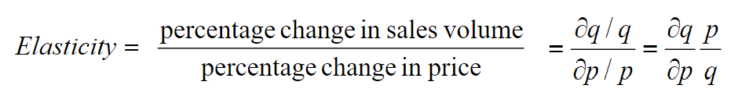
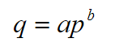
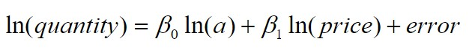
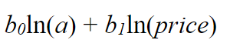
We assumed a non-linear, constant elasticity relationship between demand and price to run regressions
Log-Log transformation
Estimated demand function

Slide 37
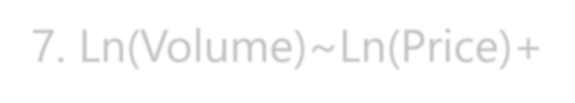














328 regressions to ID price elastic/inelastic products and other critical variables that influence purchasing decisions
7. Ln(Volume)~Ln(Price)+TDP+Season+Inflation+Temperature+Sunshine Duration
6 Segments + 8 Step Regressions (+Brand)
=> Brand Influence
6. Ln(Volume)~Ln(Price)+TDP+Season+Inflation+Temperature
5. Ln(Volume)~Ln(Price)+TDP+Season+Inflation
328 Regressions
4. Ln(Volume)~Ln(Price)+TDP+Season
3. Ln(Volume)~Ln(Price)+TDP
Adjusted R²
40 Product Keys + 7 Step Regressions
=> Price Elasticity
2. Ln(Volume)~TDP
1. Ln(Volume)~Ln(Price)

Slide 38

Output

Slide 39


Demand curves didn’t show a strong relationship between price and quantity demanded
Example plots: Hansaplast Classic Streifen Classic 2M X 6M 1 ST
Price and Volume change over time
Price and Volume plot per week

Slide 40


Regression results for 8 out of the 40 products examined demonstrated non-significant price elasticity coefficient (but significant coef for TDP)
EIGENMARKE DIVERSE 24 ST + FINGERPFLASTER EIGENMARKE DIVERSE 10 ST + FINGERPFLASTER EIGENMARKE DIVERSE 28 ST + FINGERPFLASTER EIGENMARKE 6 CM X 10 CM 20 ST + METERWARE
HANSAPLAST SPRUEHPFLASTER SPRAY 1 ST + SPRUEHPFLASTER HANSAPLAST SENSITIVE PFLASTER XXL 5 ST + XL/XXL HANSAPLAST UNIVERSAL STRIPS UNIVERSAL 40 ST + STRIPS FIGO ERSTE HILFE WUNDPFLASTER DIVERSE 36 ST+ STRIPS
Results for other 32 products had both TDP coefficient and price elasticity coefficients significant i.e. demand can be explained partially by changes in price

Slide 41
Demand is more price elastic for BDF products (Hansaplast) and TDP is less impactful to BDF products than to Private Labels
Elasticity and TDP coefficient for all 40 products by brand
Average weekly sales

Slide 42

Quantity demanded for BDF products with larger sales was more sensitive to price and less impacted by TDP
Elasticity and TDP coefficient for BDF products by sub-segment
Average weekly sales

Slide 43

Model results
Slide Reference
Usage: Mandatory
Description: What should the team do if the KPI shows a downturn in performance (e.g., out-of-control condition)?
Instructions: Detail your plan on how to respond to a performance excursion (i.e., special cause variation). Include screenshots of reaction plans and Include details of who is responsible for this response plan moving forward, etc.
POC Promo Machine Learning
Define Phase
Initial results back on Test set hitting F1 score of 0.88 – well above the 0.5 threshold set earlier.
Feature scores – top performing being amount of advance and WS reported scores

Slide 44

STRIPS - opportunity for BDF to increase brand equity
Fit Variables ^{Adjusted}
R2
Volume_Ln~Price_Ln 6.6%
Volume_Ln~TDP 30.1%
Volume_Ln~Price_Ln+TDP 38.8%
Volume_Ln~Price_Ln+TDP+Brand 55.2%
Volume_Ln~Price_Ln+TDP+Brand+Season 55.5%
Volume_Ln ~ Price_Ln + TDP + Brand+Season + CPI 55.5% Volume_Ln ~ Price_Ln + TDP + Brand+Season + CPI + Temperature 55.5% Volume_Ln ~ Price_Ln + TDP + Brand+Season + CPI + Temperature + Sunshine 55.5%
Variables | Coef | Sig
(Intercept) | 5.2775 | 
Price_Ln | (0.8959) | 
TDP | 0.1518 | 
BrandCOSMOPLAST | (0.4489) | 
BrandDOCMORRIS | 2.3577 | 
BrandHANSAPLAST | (0.2994) | 
BrandKALFF | 0.7641 | 
BrandPRIVATE LABELS | 0.6324 | 
BrandSANA | 0.1972 | 
BrandSANAPLAST | 1.0770 | 
SeasonSpring | 0.0369 | x
SeasonSummer | 0.2931 | 
SeasonWinter | (0.0266) | x
STRIPS segment is price elastic due to negative Price_Ln coefficient
There is a strong relationship between volume of the sales and TDP i.e. weighted distribution
Brand Hansaplast has one of the lowest brand recognition
Seasonality factor - summer time positively influences the sales volume

Slide 45
BDF can increase sales volume by increasing TDP for 1 product in the segment
 |  | Price_Ln |  | TDP |  | Spring |  | Summer |  | Winter |  | CPI |  | Temperature |  | Sunshine
Combo | Adj R2 | Coeff Sign |  | Coeff Sign |  | Coeff Sign |  | Coeff Sign |  | Coeff Sign |  | Coeff Sign |  | Coeff Sign |  | Coeff Sign
HANSAPLAST AQUA PROTECT STRIPS 20 ST | 87.1% | (6.76) | Yes | 0.031 | Yes | (0.010) | No | 0.369 | Yes | 0.044 | No | 0.037 | No | (0.002) | No | 0.001 | Yes
HANSAPLAST SENSITIVE STRIPS 20 ST | 84.8% | (4.72) | Yes | 0.027 | Yes | (0.016) | No | 0.299 | Yes | (0.021) | No | 0.029 | No | (0.007) | No | 0.001 | Yes
HANSAPLAST UNIVERSAL STRIPS 40 ST | 83.3% | 0.11 | No | 0.060 | Yes | 0.023 | No | 0.345 | Yes | (0.005) | No | (0.006) | No | (0.005) | No | 0.001 | Yes
HANSAPLAST DRK MIX PACK DIVERSE 20 ST | 89.6% | (8.04) | Yes | 0.052 | Yes | 0.132 | Yes | 0.334 | Yes | 0.144 | No | 0.156 | Yes | 0.006 | No | 0.001 | Yes
HANSAPLAST WATERPROOF 16 ST | 72.7% | (6.33) | Yes | 0.050 | Yes | 0.041 | No | 0.413 | Yes | (0.018) | No | 0.173 | Yes | 0.001 | No | 0.000 | No
HANSAPLAST STREIFEN ELASTIC 20 ST | 69.8% | (1.64) | No | 0.050 | Yes | 0.150 | Yes | 0.376 | Yes | 0.019 | No | 0.221 | Yes | 0.002 | No | 0.000 | No
HANSAPLAST SILICONE SOFT DIVERSE 8 ST | 61.9% | (21.68) | Yes | 0.063 | Yes | 0.281 | No | 0.615 | Yes | 0.133 | No | 0.078 | No | (0.010) | No | 0.002 | No
HANSAPLAST KIDS FROZEN DIVERSE 16 ST | 71.1% | (0.78) | Yes | 0.198 | Yes | 0.434 | Yes | 0.589 | Yes | 0.381 | Yes | 0.380 | Yes | (0.051) | Yes | 0.002 | No
EIGENMARKE DIVERSE 20 ST | 51.3% | (0.16) | Yes | 0.146 | Yes | (0.083) | No | 0.079 | No | 0.065 | No | 0.118 | Yes | 0.012 | No | 0.000 | No
EIGENMARKE 8 CM X 10 CM 5 ST | 56.0% | 1.40 | Yes | 0.144 | Yes | 0.204 | No | 0.536 | Yes | (0.278) | No | (0.102) | No | (0.102) | Yes | 0.004 | Yes
EIGENMARKE DIVERSE 40 ST | 36.4% | 0.33 | Yes | 0.208 | Yes | 0.096 | No | 0.369 | Yes | 0.058 | No | (0.350) | Yes | 0.026 | No | (0.002) | No
EIGENMARKE DIVERSE 24 ST | 64.8% | (0.68) |  |  | Yes
 |  |  | No | 0.188 |  | - NA |  | (0.168) | No | 0.157 | No | 0.481 | No | 0.120 | No | 0.003 | No
EIGENMARKE DIVERSE 16 ST | 74.1% | 3.51 |  |  | Yes
 |  |  | Yes | 0.168 |  | (0.154) | No | 0.592 | Yes | (0.445) | Yes | 0.460 | Yes | (0.034) | No | 0.002 | No
EIGENMARKE WUNDSCHNELLVERBAENDE | 67.3% | (4.36) |  |  | Yes |  |  |  | Yes
 |  |  | Yes | 0.086 |  | 1.497 | Yes | (0.992) |  | - NA |  | (0.071) | No | 0.267 | Yes | 0.002 | No
EIGENMARKE DIVERSE 30 ST | 16.7% | (0.31) |  |  | Yes |  |  |  |  |  |  |  | No
 |  |  | Yes | 0.228 |  | 0.086 | No | 0.064 | No | 0.076 | No | 0.032 |  | (0.004) | No | (0.000) | No
EIGENMARKE DIVERSE 10 ST | 73.1% | (0.43) |  |  | Yes |  | No |  | No |  |  |  |  |  | No
 |  |  | Yes | 0.336 |  | (0.119) |  | 0.171 |  | 0.071 | No | (0.319) | Yes | (0.011) |  | 0.003 | Yes
FIGO ERSTE HILFE DIVERSE 36 ST | 76.0% | 1.19 |  |  | Yes |  |  |  |  |  |  |  | Yes |  |  |  | Yes
 |  |  | No | 0.277 |  | 0.395 | Yes | 0.988 | Yes | (0.130) | No | (0.281) |  | (0.067) | Yes | 0.004
TDP explains most of the variation in volume for Hansaplast products.
Further increase in TDP provides only marginal positive impact (ex. 0.05 vs 0.18 for private labels)
HANSAPLAST KIDS FROZEN
DIVERSE 16 ST has a high TDP coefficient i.e. additional sales can be obtained by increasing TDP
iv. HANSAPLAST SILICONE SOFT DIVERSE 8 ST – no
further price increases are recommended
Summer season along with sunshine duration positively influences demand from customers
iii.
Fit Variables
Adj R2
 | Volume_Ln~Price_Ln | 8.7% | v.
 | Volume_Ln~TDP | 69.9%
 | Volume_Ln~Price_Ln+TDP | 74.5%
 | Volume_Ln~Price_Ln+TDP+Season | 86.2%
 | Volume_Ln ~ Price_Ln + TDP + Season + CPI | 86.3%
 | Volume_Ln ~ Price_Ln + TDP + Season + CPI + Temperature | 86.6%
Page 20 | Volume_Ln ~ Price_Ln + TDP + Season + CPI + Temperature + Sunshine | 87.1%

Slide 46

METERWARE - opportunity for BDF to increase brand equity
Fit Variables ^{Adjusted}
R2
Volume_Ln~Price_Ln 2.19%
Volume_Ln~TDP 30.88%
Volume_Ln~Price_Ln+TDP 36.73%
Volume_Ln~Price_Ln+TDP+Brand 51.40%
Volume_Ln~Price_Ln+TDP+Brand+Season 51.52%
Volume_Ln ~ Price_Ln + TDP + Brand+Season + CPI 51.51% Volume_Ln ~ Price_Ln + TDP + Brand+Season + CPI + Temperature 51.51% Volume_Ln ~ Price_Ln + TDP + Brand+Season + CPI + Temperature + Sun 51.51%
 | Variables | Coef | Sig
 | (Intercept) | 4.4758 | 
 | Price_Ln | (0.1728) | 
 | TDP | 0.1119 | 
 | BrandDUKAPLAST | 0.8920 | 
 | BrandGOTHAPLAST | 0.2883 | 
 | BrandHANSAPLAST | (0.1171) | x
 | BrandKALFF | 1.4158 | 
 | BrandPRIVATE LABELS | 1.9004 | 
 | BrandSANA | 1.1186 | 
 | SeasonSpring | 0.1110 | 
 | SeasonSummer | 0.2560 | 
Page 21 | SeasonWinter | 0.0960 | 
METERWARE segment is marginally price elastic due to neutral Price_Ln coefficient
There is a strong relationship between volume of the sales and TDP i.e. weighted distribution
Brand Hansaplast has one of the lowest brand recognition, but its coefficient is not significant
Seasonality factor - summer time positively influences the sales volume

Slide 47
BDF can increase sales volume by increasing TDP for 2 products in the segment
Combo Adj R2 HANSAPLAST STREIFEN CLASSIC 2 M X 6 CM 1 ST 84.3% HANSAPLAST STREIFEN CLASSIC 1 M X 6 CM 1 ST 83.2% HANSAPLAST WUNDPFLASTER SENSITIV 1 M X 6 CM 1 ST 85.2% HANSAPLAST UNIVERSAL STREIFEN 1 M X 6 CM 1 ST 82.8% HANSAPLAST ELASTIC STREIFEN 1 M X 6 CM 1 ST 82.6% EIGENMARKE 10 CM X 6 CM 10 ST 37.3% EIGENMARKE 1 M X 6 CM 1 ST 37.3% EIGENMARKE 6 CM X 10 CM 20 ST 42.1% | Price_Ln |  | TDP |  | Season_Spring |  | Season_Summer |  | Season_Winter |  | CPI |  | Temperature |  | Sunshine
 | Coeff Sign |  | Coeff Sign |  | Coeff Sign |  | Coeff Sign |  | Coeff Sign |  | Coeff Sign |  | Coeff Sign |  | Coeff Sign
 | (12.730) (2.252) (5.437) (0.696) 0.669 0.169 0.169 (1.875) | Yes Yes Yes | 0.025 0.023 0.025 0.060 0.094 0.150 0.150 0.162 | Yes Yes Yes Yes Yes Yes Yes Yes | 0.007 0.004 (0.039) (0.015) 0.046 (0.146) (0.146) 0.010 | No No No No No No No No | 0.294 0.298 0.277 0.350 0.356 (0.098) (0.098) 0.183 | Yes Yes Yes Yes Yes | 0.028 (0.016) (0.026) (0.067) (0.062) 0.051 0.051 0.081 | No No No No No No No No | 0.020 (0.017) 0.019 (0.017) 0.067 (0.096) (0.096) (0.039) | No No No No No No No No | (0.008) (0.006) (0.011) (0.013) (0.004) (0.008) (0.008) (0.001) | No No No | 0.001 0.001 0.001 - 0.001 0.001 0.001 0.000 | Yes Yes Yes Yes Yes
 |  | No No |  |  |  |  |  |  |  |  |  |  |  | Yes
 |  |  |  |  |  |  |  |  |  |  |  |  |  | No No No No
 |  | Yes Yes |  |  |  |  |  | No No No |  |  |  |  |  |  |  | No No No
 |  | No
Fit Variables Adj R2
Volume_Ln~Price_Ln 2.0%
Volume_Ln~TDP 74.1%
Volume_Ln~Price_Ln+TDP 75.4%
Volume_Ln~Price_Ln+TDP+Season 83.6%
Volume_Ln ~ Price_Ln + TDP + Season + CPI 83.6%
Volume_Ln ~ Price_Ln + TDP + Season + CPI + Temperature 83.7% Volume_Ln ~ Price_Ln + TDP + Season + CPI + Temperature + Sunshine 84.3%
TDP explains most of the variation in volume for Hansaplast products.
HANSAPLAST ELASTIC STREIFEN 1 M X 6 CM 1 ST and HANSAPLAST
UNIVERSAL STREIFEN 1 M X 6 CM 1 ST have better TDP coefficients
i.e. additional sales can be obtained by increasing TDP
Demand for private labels, the main competition, is only partially explained by price and TDP
Summer season along with sunshine duration positively infuences demand from customers

Slide 48


Recommendations
Increase prices for select products with positive price elasticity coefficient
Increase TDP for products with higher than market TDP coefficients
Design brand recognition campaigns for segments with the lowest brand recognition scores
Review SKUs and engage in SKU rationalization to strengthen the brand
Increase prices during
summer and conduct
promotional campaigns
during other seasons

Slide 49
Appendix

Slide 50

BDF has medium brand equity in FIXIERPFLASTER segment
Fit Variables ^{Adjusted}
R2
Volume_Ln~Price_Ln 1.01%
Volume_Ln~TDP 49.58%
Volume_Ln~Price_Ln+TDP 50.08%
Volume_Ln~Price_Ln+TDP+Brand 69.94%
Volume_Ln~Price_Ln+TDP+Brand+Season 70.10%
Volume_Ln ~ Price_Ln + TDP + Brand+Season + CPI 70.13% Volume_Ln ~ Price_Ln + TDP + Brand+Season + CPI + Temperature 70.16% Volume_Ln ~ Price_Ln + TDP + Brand+Season + CPI + Temperature + Sunshine 70.18%
Variables | Coef | Sig
(Intercept) | 4.3858 | 
Price_Ln | (0.1470) | 
TDP | 0.1002 | 
BrandGOTHAPLAST | 1.0635 | 
BrandHANSAPLAST | 0.6242 | 
BrandOTHERS | (0.2182) | 
BrandPAPSTAR | (0.3087) | 
BrandPRIVATE LABELS | 1.2668 | 
SeasonSpring | 0.0422 | X
SeasonSummer | 0.2499 | 
SeasonWinter | (0.0334) | X
FIXIERPFLASTER segment is marginally price elastic due to almost neutral Price_Ln coefficient
There is a strong relationship between volume of the sales and TDP i.e. weighted distribution
Brand Hansaplast has 3rd strongest recognition after private labels and Gothaplast
Seasonality factor - summer time positively influences the sales volume

Slide 51
BDF can increase price for 1 product in the segment but most demand is driven by TDP with marginal returns
 |  | Price_Ln |  | TDP |  | Season_Spring |  | Season_Summer |  | Season_Winter |  | CPI |  | Temperature |  | Sunshine
Product Name | Adj R2 | Coeff Sign |  | Coeff Sign |  | Coeff | Sign | Coeff | Sign | Coeff | Sign | Coeff Sign |  | Coeff Sign |  | Coeff Sign
HANSAPLAST SENSITIVE 5 M X 2.5 CM 1 ST | 84.9% | (8.847) | Yes | 0.026 | Yes | (0.035) | No | 0.255 | Yes | (0.017) | No | 0.056 | No | (0.003) | No | 0.001 | Yes
HANSAPLAST CLASSIC 5 M X 2.5 CM 1 ST | 85.1% | (5.114) | Yes | 0.032 | Yes | (0.009) | No | 0.280 | Yes | (0.021) | No | 0.033 | No | (0.009) | No | 0.001 | Yes
HANSAPLAST CLASSIC 5 M X 1.25 CM 1 ST | 76.3% | 4.760 | Yes | 0.036 | Yes | 0.033 | No | 0.313 | Yes | (0.009) | No | 0.111 | Yes | (0.014) | No | 0.001 | Yes
EIGENMARKE 5 M X 2.5 CM 1 ST | 68.2% | 1.108 | Yes | 0.180 | Yes | 0.118 | No | 0.222 | No | 0.004 | No | 0.056 | No | (0.023) | No | 0.002 | No
Adjusted R2
2.4%
75.3%
77.3%
84.5%
84.7%
84.7%
84.9%
TDP explains most of the variation in volume for Hansaplast product. Further increase in TDP provides only marginal positive
impact (ex. 0.03 vs 0.18 for private labels)
Private labels have more capacity to increase prices and to increase TDP for growing demand
HANSAPLAST CLASSIC 5 M X 1.25 CM 1 ST has positive Price_Ln coefficint i.e. price of this product can be increased
Summer season along with sunshine duration and temperature positively infuence demand from customers
Fit Variables
Volume_Ln~Price_Ln Volume_Ln~TDP Volume_Ln~Price_Ln+TDP Volume_Ln~Price_Ln+TDP+Season
Volume_Ln ~ Price_Ln + TDP + Season + CPI Volume_Ln ~ Price_Ln + TDP + Season + CPI + Temp
Volume_Ln ~ Price_Ln + TDP + Season + CPI + Temp + Sun

Slide 52

BDF has strong brand equity in FINGERPFLASTER segment
Fit Variables Adjusted R2
Volume_Ln~Price_Ln 0.63%
Volume_Ln~TDP 45.43%
Volume_Ln~Price_Ln+TDP 47.05%
Volume_Ln~Price_Ln+TDP+Brand 64.08%
Volume_Ln~Price_Ln+TDP+Brand+Season 64.22%
Volume_Ln ~ Price_Ln + TDP + Brand+Season + CPI 64.24% Volume_Ln ~ Price_Ln + TDP + Brand+Season + CPI + Temperature 64.25% Volume_Ln ~ Price_Ln + TDP + Brand+Season + CPI + Temperature + Suns 64.25%
Variables | Coef | Sig
(Intercept) | 3.9901 | 
Price_Ln | (1.0818) | 
TDP | 0.1342 | 
BrandGOTHAPLAST | 0.9338 | 
BrandHANSAPLAST | 2.1888 | 
BrandPRIVATE LABELS | 2.2120 | 
SeasonSpring | (0.0228) | X
SeasonSummer | 0.2304 | 
SeasonWinter | 0.0066 | X
FINGERPFLASTER segment is price elastic due to negative Price_Ln coefficient
There is a strong relationship between volume of the sales and TDP i.e. weighted distribution
Brand Hansaplast has 2nd strongest recognition after private labels
Seasonality factor - summer time positively influences the sales volume

Slide 53
BDF can increase price for 1 product in the segment but most demand is driven by TDP with marginal returns
 |  | Price_Ln |  | TDP |  | Spring |  | Summer |  | Winter |  | CPI |  | Temperature |  | Sunshine
Product Name | Adjusted R2 | Coeff Sign |  | Coeff Sign |  | Coeff | Sign | Coeff | Sign | Coeff | Sign | Coeff | Sign | Coeff | Sign | Coeff | Sign
HANSAPLAST SELBSTHAFTENDER 5 M X 2.5 CM 1 ST | 65.0% | 14.30 | Yes | 0.05 | Yes | 0.2197 | No | 0.4547 | Yes | 0.0337 | No | 0.3558 | Yes | (0.0631) | Yes | 0.0030 | Yes
HANSAPLAST FINGERSTRIPS 1.9 CM X 12 CM 16 ST | 84.2% | (2.54) | Yes | 0.05 | Yes | 0.0347 | No | 0.3232 | Yes | (0.0494) | No | 0.0069 | No | (0.0190) | Yes | 0.0009 | Yes
EIGENMARKE DIVERSE 24 ST | 58.2% | 0.03 | No | 0.14 | Yes | (0.0818) | No | (0.3848) | No | (0.1191) | No | 0.6992 | Yes | 0.1003 | No | (0.0001) | No
EIGENMARKE DIVERSE 28 ST | 41.7% | 1.18 | No | 0.50 | Yes | 0.0989 | No | 0.5146 | Yes | 0.3854 | Yes | 0.2195 | No | (0.0357) | No | 0.0015 | No
EIGENMARKE DIVERSE 16 ST | 73.5% | 3.37 | Yes | 0.16 | Yes | (0.1014) | No | 0.0496 | No | 0.0088 | No | (0.0175) | No | (0.0310) | Yes | (0.0002) | No
EIGENMARKE DIVERSE 10 ST | 77.0% | 5.43 | No | 0.32 | Yes | 0.0832 | No | 0.2724 | Yes | 0.0325 | No | 0.0544 | No | (0.0017) | No | 0.0009 | No
EIGENMARKE 2.5 CM X 4 M 1 ST | 54.6% | 2.72 | Yes | 0.17 | Yes | (0.1033) | No | 0.4077 | No | (0.1784) | No | 0.0252 | No | (0.0298) | No | 0.0010 | No
Fit Variables Adjusted R2
Volume_Ln~Price_Ln 2.2%
Volume_Ln~TDP 79.2%
Volume_Ln~Price_Ln+TDP 80.4%
Volume_Ln~Price_Ln+TDP+Season 83.8%
Volume_Ln ~ Price_Ln + TDP + Season + CPI 83.7%
Volume_Ln ~ Price_Ln + TDP + Season + CPI + Temp 83.9% Volume_Ln ~ Price_Ln + TDP + Season + CPI + Temp + Sun 84.2%
TDP explains most of the variation in volume for Hansaplast product. Further increase in TDP provides only marginal positive
impact (ex. 0.05 vs 0.14 to 0.50 for private labels)
Private labels have more capacity to increase prices and to increase TDP for growing demand
HANSAPLAST SELBSTHAFTENDER 5 M X 2.5 CM 1 ST has positive
Price_Ln coefficint i.e. price of this product can be increased
Summer season along with sunshine duration and temperature positively infuence demand from customers

Slide 54

Increase price and TDP in SPRUEHPFLASTER segment
Fit Variables Adj R2
Volume_Ln~Price_Ln 18.2%
Volume_Ln~TDP 40.6%
Volume_Ln~Price_Ln+TDP 53.1%
Volume_Ln~Price_Ln+TDP+Brand 53.4%
Volume_Ln~Price_Ln+TDP+Brand+Season 55.1%
Volume_Ln ~ Price_Ln + TDP + Brand+Season + CPI 55.0% Volume_Ln ~ Price_Ln + TDP + Brand+Season + CPI + Temp 55.3% Volume_Ln ~ Price_Ln + TDP + Brand+Season + CPI + Temp + Sun 55.4%
Product Name HANSAPLAST SPRUEHPFLASTER SPRAY 1 ST EIGENMARKE 1 ST
Adj R2
78.6%
47.7%
Price_Ln |  | TDP |  | Spring |  | Summer
Coeff Sign |  | Coeff Sign |  | Coeff Sign |  | Coeff Sign
0.900 2.262 | No | 0.291 0.250 | Yes | 0.009 0.240 | No | 0.396 0.356 | Yes
 | Yes |  | Yes |  | No |  | No
Segment is more price inelastic, and BDF can increase price for its product HANSAPLAST SPRUEHPFLASTER SPRAY 1 ST and get increase in the demand from the customers
Further increase in TDP will also provide sizable positive impact on sales volume (ex. 0.29 vs 0.25 for private labels)
Summer season positively influences demand from customers

Slide 55

Increase TDP in SPRUEHPFLASTER segment
Fit Variables Adj R2
Volume_Ln~Price_Ln 9.9%
Volume_Ln~TDP 42.5%
Volume_Ln~Price_Ln+TDP 45.3%
Volume_Ln~Price_Ln+TDP+Brand 63.2%
Volume_Ln~Price_Ln+TDP+Brand+Season 63.2%
Volume_Ln ~ Price_Ln + TDP + Brand+Season + CPI 63.2% Volume_Ln ~ Price_Ln + TDP + Brand+Season + CPI + Temp 63.3% Volume_Ln ~ Price_Ln + TDP + Brand+Season + CPI + Temp + 63.5%
Price_Ln |  | TDP | SeasonSpring |  | SeasonSummer | Temperature |  | Sunshine
Coeff | Sign | Coeff Sign | Coeff | Sign | Coeff Sign | Coeff Sign |  | Coeff Sign
8.41 | Yes | 0.114 Yes | (0.641) | Yes | (0.649) Yes | (0.027) | No | 0.004 | Yes
0.69 | No | 0.257 Yes | 0.109 | No | 0.677 Yes | (0.029) | Yes | 0.001 | No
Product Name EIGENMARKE XXL 5 ST HANSAPLAST SENSITIVE XXL 5 ST
Adjusted R2
63.5%
75.2%
Segment is price elastic but Hansaplast enjoys strongest brand recognition
Further increase in TDP for HANSAPLAST SENSITIVE XXL 5 ST will provide a sizable positive impact on sales volume (ex. 0.26 vs 0.11 for private labels)
Summer season positively influences demand from customers
iii.

Slide 56
Beiersdorf has less products than Private Labels
Average Weekly Numbers of Product SKU
140
120
100
80
60
40
20
0
BEIERSDORF
FINGERPFLASTER
HARTMANN
METERWARE
OTHERS PRIVATE LABELS
SPRUEHPFLASTER STRIPS WUNDNAHTPFLASTER XL/XXL
FIXIERPFLASTER

Slide 57


BDF products have higher price points than Private Label products
Ln(Price) and Ln(Volume) plots per product per week
Price distribution per product per week
BDF
Private Label

Slide 58


BDF products have higher price points and TDP values than Private Label products
TDP and Ln(Volume) plots per product per week
TDP distribution per product per week
BDF
Private Label

Slide 59
Green Belt Tollgate Review
Measure Phase

Slide 60
Baseline from 2017 aggregate: Strike Rate 14%
Slide Reference
Usage: Recommended (although depending on the project, it may not be feasible to conduct a detailed study)
Description: Overview of your MSA findings.
Instructions: Describe the results and findings of your MSA. Show the MiniTab graphical output and discuss key highlights. Populate at the bottom of the page in a clear manner whether the MSA proves or disproves you have valid data.
POC Promo Machine Learning
Measure Phase
Insert Gas Relationship Pie Chart
Key Findings:
The baseline was based on the aggregate total of strikes and inspections carried out in 2017 – measured at 14%
In the future- improvement will be compared against this baseline
Total Inspections in 2017 – 37.5K
5.2 K
Upload Minitab File
32.3 K

Slide 61
Binomial Process Capability: Strike Rate
Slide Reference
Usage: Recommended (although depending on the project, it may not be feasible to conduct a detailed study)
Description: Overview of your MSA findings.
Instructions: Describe the results and findings of your MSA. Show the MiniTab graphical output and discuss key highlights. Populate at the bottom of the page in a clear manner whether the MSA proves or disproves you have valid data.
POC Promo Machine Learning
Measure Phase
Insert Base Statistics
Key Findings:
Note: average monthly strike rate is 16.48%
However, the annual cumulative strike rate (year total strikes/year total inspections) will be the key measurement metric. In 2017 the total strike rate was 14%.
Bimodal distribution
Upload Minitab File

Slide 62
Stratified Bar Chart: Strike Rate by BU
Slide Reference
Usage: Mandatory
Description: Summarize the baseline data gathered for your KPIs via the Data Collection Plan.
Instructions: Replace with your own baseline data graphical summary. Include key findings. What type of distribution of your data? Are your data Normal? What is the mean, median, and range of your data?
Calculate and fill in your current process Sigma, Yield, and DPMO.
Note: Baseline Data Summary could include other aggregate data summaries (e.g., Boxplots) if appropriate.
POC Promo Machine Learning
Measure Phase
Share Golden Nugget
Key Findings:
Much higher strike rates in BU SJ/BU JL (21%) vs. BU W (1.2%)
No single Region above the 25% strike rate target – must apply an approach that can improve strike rate across the board
Upload Minitab File

Slide 63
Stratified Bar Chart: Inspector Strikes Distr.
Slide Reference
Usage: Mandatory
Description: Summarize the baseline data gathered for your KPIs via the Data Collection Plan.
Instructions: Replace with your own baseline data graphical summary. Include key findings. What type of distribution of your data? Are your data Normal? What is the mean, median, and range of your data?
Calculate and fill in your current process Sigma, Yield, and DPMO.
Note: Baseline Data Summary could include other aggregate data summaries (e.g., Boxplots) if appropriate.
POC Promo Machine Learning
Measure Phase
Share Golden Nugget
Key Findings:
Issue count for inspectors is widely distributed between 0 to 300 per year, not a highly stable standard because inspectors are focused on different BUs
Upload Minitab File

Slide 64

Additional Features: Sales Manager
Slide Reference
Usage: Mandatory
Description: Summarize the baseline data gathered for your KPIs via the Data Collection Plan.
Instructions: Replace with your own baseline data graphical summary. Include key findings. What type of distribution of your data? Are your data Normal? What is the mean, median, and range of your data?
Calculate and fill in your current process Sigma, Yield, and DPMO.
Note: Baseline Data Summary could include other aggregate data summaries (e.g., Boxplots) if appropriate.
POC Promo Machine Learning
Measure Phase
Share Golden Nugget
Key Findings:
Source – raw inspection data provided by Inspection team in 2017 (List of managers is ranked by sales managers with most issues to least issues, the cumulative count of issues is tracked in the y column)
The 75 sales managers with the most non-compliance issues represent 80% of the total issues discovered.
Will want to look into Sales Manager as a variable for finding Non-compliance issues
Upload Minitab File

Slide 65
Green Belt Tollgate Review
Analyze Phase

Slide 66

Overview of Analysis Phase Activities
Slide Reference
Usage: Mandatory
Description: What should the team do if the KPI shows a downturn in performance (e.g., out-of-control condition)?
Instructions: Detail your plan on how to respond to a performance excursion (i.e., special cause variation). Include screenshots of reaction plans and Include details of who is responsible for this response plan moving forward, etc.
POC Promo Machine Learning
Define Phase
Feature Engineering
Brainstorming
Feature hypothesis
Data cleansing:
Data set integration
Cleansing
Model fitting
Feature testing and selection
Model testing and evaluation
Feature selection
Model selection
Note: will not utilize Ensemble Learning in this case

Slide 67
Data cleansing and transformation
Slide Reference
Usage: Mandatory
Description: What should the team do if the KPI shows a downturn in performance (e.g., out-of-control condition)?
Instructions: Detail your plan on how to respond to a performance excursion (i.e., special cause variation). Include screenshots of reaction plans and Include details of who is responsible for this response plan moving forward, etc.
POC Promo Machine Learning
Define Phase
Data cleansing tasks | Description | Handling Approach | Examples
Column breakouts | Split features with more than 1 piece of information in a single cell. (I.e. wholesaler ID and name in “0030003454|杭州近江食品市场锦达食品经营部”) | Python code for automatic detection and column breakout | POA Datasource: POA Code, Region, Area, Territory, Wholesaler
Missing data removal | Features with missing IDs are removed from the dataset. (I.e. 3 of 7k records missing a POA code) | Python code for automatic detection and removal | POA Code Miss matches between Inspection/Issue data list and POA list Regions missing either non/compliant
Anomaly removal | Using business expertise to identify situations which do not normally happen and should not be considered in the machine learning process | Manual adjustments on a case by case basis | Harbin case in 2016 Mudanjiang case in 2017
Data entry mistakes | Manual data entry leads to poor quality information | Python code for automatic detection and adjustment or removal | Most of POA Inspection/Issue lists have data entry mistakes in each column

Slide 68

Cleaning Example -
Slide Reference
Usage: Mandatory
Description: What should the team do if the KPI shows a downturn in performance (e.g., out-of-control condition)?
Instructions: Detail your plan on how to respond to a performance excursion (i.e., special cause variation). Include screenshots of reaction plans and Include details of who is responsible for this response plan moving forward, etc.
POC Promo Machine Learning
Define Phase
Mudan Jiang Anomaly
Discovery – modelling team identifies anomaly in Mudan Jiang province where there was an extra ordinary increase in compliant cases
Approach – anomaly questioned in weekly project status. Function team explains this was a solitary instance where each POC individually needed an individual POA (normally can be grouped).
Mitigation – Modelling team asked to remove these POAs from analysis.
MUDAN JIANG ANOMALOUS COMPLIANT INSPECTIONS 2017
Anomaly

Slide 69


Modelling software and type
Slide Reference
Usage: Mandatory
Description: What should the team do if the KPI shows a downturn in performance (e.g., out-of-control condition)?
Instructions: Detail your plan on how to respond to a performance excursion (i.e., special cause variation). Include screenshots of reaction plans and Include details of who is responsible for this response plan moving forward, etc.
POC Promo Machine Learning
Define Phase
GRADIENT BOOSTED DECISION TREES PROCESS
Description:
XG Boost is an open source software library which provides the gradient boosting decision tree framework for Python, R, and other modelling software.
Python is the platform which runs the XGBoost library.
Description:
A series of simple decision trees which learn off the weakness of previous decision trees to improve predictions in problem areas. It has gained much popularity and attention recently as it was the algorithm of choice for many winning teams of a number of machine learning competitions.
It is a very strong initial model for providing a baseline performance level.

Slide 70
Feature evaluation process
Slide Reference
Usage: Mandatory
Description: What should the team do if the KPI shows a downturn in performance (e.g., out-of-control condition)?
Instructions: Detail your plan on how to respond to a performance excursion (i.e., special cause variation). Include screenshots of reaction plans and Include details of who is responsible for this response plan moving forward, etc.
POC Promo Machine Learning
Define Phase
A feature’s importance is measured by the number of times the decision trees decides to make decision “splits” on that feature:
Overall, Gradient Boost Decision tree is many simple decision trees (or decision stumps) layered on eachother to iteratively solve the weaknesses of the previous stump.
High priority features that predict most accurately and with as much coverage, the goal metric, then loops through all following features.
Feature importance determined by number of splits. A feature with >0 splits is kept in the model.
XG Boost Feature Valuation Example
Gradient Boosted Tree
Yes
Is wholesaler A,C or D?
No
Compliant
Discount Rate < 5RMB / Case
Compliant
Non-compliant
Errors
Yes
Is wholesaler E,G
No
Compliant
Non-compliant

Slide 71
Model test design
Slide Reference
Usage: Mandatory
Description: What should the team do if the KPI shows a downturn in performance (e.g., out-of-control condition)?
Instructions: Detail your plan on how to respond to a performance excursion (i.e., special cause variation). Include screenshots of reaction plans and Include details of who is responsible for this response plan moving forward, etc.
POC Promo Machine Learning
Define Phase
Data sets split by importance, favoring recent data to be used for most important modelling construction and evaluation
Training (201601 – 201708)
Test (201709 – 201712)
Validation (201801 – 201805)
Purpose:
Largest part of the data set used teach ML algorithms what data patterns lead to non-compliance. Older data is used so that more recent data can be saved for later model accuracy evaluation.
Target Metric:
Test set F-score of 0.5 – suggesting 0.5 strike rate
(using F-score as its “Precision” metric conveniently calculates the “Strike Rate” target)
Evaluation Date:
2018/06/30
Purpose:
A “hold-out” data set where we know the non-compliance status but hide from the trained ML. ML makes a prediction on this data and we compare to actuals to see how accurately this model predicts. The test set helps prevent “overfitting” where an ML has memorized answers from Training set. A more recent data set makes sure the model can handle recent issues.
Target Metric:
F-score 0.5 – suggesting 0.5 strike rate
(using F-score as its “Precision” metric conveniently calculates the “Strike Rate” target)
Evaluation Date:
2018/06/30
Purpose:
A final in-field test where actual inspection results are compared to the ML predictions.
Approach:
Machine prioritizes POA list highest to lowest non-compliance probabilities. Random testing is done to see if probability corresponds to issue discovery.
Target Metric:
Strike Rate > 0.25
Evaluation Date:
2018/11/30

Slide 72

Model Training Using Boosted Decision Trees
Slide Reference
Usage: Mandatory
Description: What should the team do if the KPI shows a downturn in performance (e.g., out-of-control condition)?
Instructions: Detail your plan on how to respond to a performance excursion (i.e., special cause variation). Include screenshots of reaction plans and Include details of who is responsible for this response plan moving forward, etc.
POC Promo Machine Learning
Define Phase
Example image of a single decision tree in the POC Promo Non-compliance Model
1 of 800 such trees layered over another
Training data: 15k records
Test data: 2.6k records

Slide 73
Model results
Slide Reference
Usage: Mandatory
Description: What should the team do if the KPI shows a downturn in performance (e.g., out-of-control condition)?
Instructions: Detail your plan on how to respond to a performance excursion (i.e., special cause variation). Include screenshots of reaction plans and Include details of who is responsible for this response plan moving forward, etc.
POC Promo Machine Learning
Define Phase
Initial results back on Test set hitting F1 score of 0.88 – well above the 0.5 threshold set earlier.
Feature scores – top performing being amount of advance and WS reported scores

Slide 74
Green Belt Tollgate Review
Improve Phase

Slide 75
Overview of Improvement Phase
Slide Reference
Usage: Mandatory
Description: What should the team do if the KPI shows a downturn in performance (e.g., out-of-control condition)?
Instructions: Detail your plan on how to respond to a performance excursion (i.e., special cause variation). Include screenshots of reaction plans and Include details of who is responsible for this response plan moving forward, etc.
POC Promo Machine Learning
Define Phase
Updates
Discount size clarified
Improvements to model
Re-modelling
Feature selection
Model selection
Pilot
Prioritization
Pilot results and benchmarking
Results and Benefits
Size of pie estimation
Strike rate benefit
Other use cases and benefits
Note: will not utilize Ensemble Learning in this case

Slide 76
Background - Update
Slide Reference
Usage: Recommended
Description: Description / visualization of process to identify possible solutions.
Instructions: Leaving the Analyze phase you should have your shortlist of root causes. Begin the Improve phase with brainstorming to identify possible solutions. Prepare your findings on this slide (details, affinity diagrams, etc.)
Improve Phase
Total of $2.2Bio in commercial investments during 2017
POC Promotion (including Listing Fee) makes up the largest share of investment at $824Mio
PBO Non-compliance ML pilot already successfully run and scaleup is underway

Slide 77
Periodic review/improve with function
Slide Reference
Usage: Optional
Description: Technical details of your selected solution(s).
Instructions: Document any technical considerations of your design here. This could be supporting technology, design diagrams, specifications, requirements, etc.
*May require multiple slides*
Improve Phase
Additional Logic Layers
Example: POA Grouping
Logic | Description | Solution
POA Grouping | Wholesalers will hide non-compliance by breaking out discount application into discount amounts below 2k RMB flag levels. | Machine Learning regroups POAs by wholesaler/month/sku to analyze the total discount application vs the artificially smaller application amount.
POA Application Lag | Non-compliant applications may take more time to process as fake evidence and standard in process flagging would delay application time | Feature added to consider the application time length
Approve POA
3K RMB Paid Out
N
POA Discount
3K RMB
POA > 2K
Flag POA
No Discount Paid
Y
POA Discount
1K RMB
Approve POA
3K RMB Paid Out
N
POA Discount
1K RMB
POA > 2K
Flag POA
No Discount Paid
POA Discount
1K RMB
Y
Notes:
Add another slide that shows Pilot design or adjust slide to show updated map/design
(Dave to talk to Don)

Slide 78
Modelling software and type
Slide Reference
Usage: Mandatory
Description: What should the team do if the KPI shows a downturn in performance (e.g., out-of-control condition)?
Instructions: Detail your plan on how to respond to a performance excursion (i.e., special cause variation). Include screenshots of reaction plans and Include details of who is responsible for this response plan moving forward, etc.
POC Promo Machine Learning
Define Phase
GRADIENT BOOSTED DECISION TREES PROCESS
Description:
XG Boost is an open source software library which provides the gradient boosting decision tree framework for Python, R, and other modelling software.
Python is the platform which runs the XGBoost library.
Description:
A series of simple decision trees which learn off the weakness of previous decision trees to improve predictions in problem areas. It has gained much popularity and attention recently as it was the algorithm of choice for many winning teams of a number of machine learning competitions.
It is a very strong initial model for providing a baseline performance level.

Slide 79
Feature evaluation process
Slide Reference
Usage: Mandatory
Description: What should the team do if the KPI shows a downturn in performance (e.g., out-of-control condition)?
Instructions: Detail your plan on how to respond to a performance excursion (i.e., special cause variation). Include screenshots of reaction plans and Include details of who is responsible for this response plan moving forward, etc.
POC Promo Machine Learning
Define Phase
A feature’s importance is measured by the number of times the decision trees decides to make decision “splits” on that feature:
Overall, Gradient Boost Decision tree is many simple decision trees (or decision stumps) layered on eachother to iteratively solve the weaknesses of the previous stump.
High priority features that predict most accurately and with as much coverage, the goal metric, then loops through all following features.
Feature importance determined by number of splits. A feature with >0 splits is kept in the model.
XG Boost Feature Valuation Example
Gradient Boosted Tree
Yes
Is wholesaler A,C or D?
No
Compliant
Discount Rate < 5RMB / Case
Compliant
Non-compliant
Errors
Yes
Is wholesaler E,G
No
Compliant
Non-compliant

Slide 80
Model Construction
Slide Reference
Usage: Mandatory
Description: What should the team do if the KPI shows a downturn in performance (e.g., out-of-control condition)?
Instructions: Detail your plan on how to respond to a performance excursion (i.e., special cause variation). Include screenshots of reaction plans and Include details of who is responsible for this response plan moving forward, etc.
POC Promo Machine Learning
Define Phase
Example image of a single decision tree in the POC Promo Non-compliance Model
Input is POA Group ID
1 of 800 such trees layered over another
Training data: 15k records
Test data: 2.6k records

Slide 81
Top Variables
Slide Reference
Usage: Mandatory
Description: What should the team do if the KPI shows a downturn in performance (e.g., out-of-control condition)?
Instructions: Detail your plan on how to respond to a performance excursion (i.e., special cause variation). Include screenshots of reaction plans and Include details of who is responsible for this response plan moving forward, etc.
POC Promo Machine Learning
Define Phase
Top 20 features ranked by importance to non-compliance prediction (out of a total of 77). Tendency features (10 of top 20) most important to predicting non-compliance, not indicators, which is the current basis of any human analysis approach.
Name | Feature Type | Description | Importance Score
Sales Company_poa_cnt | Tendencies | for the same sales company, how many poa records available | 80
Create a person_poa_cnt | Ability | for the same person, how many poa records available | 65
Region_poa_cnt | Tendencies | for the same region, how many poa records available | 58
month | Tendencies | month | 50
reimburse_lag | Indicators | after how many months, wholesaler submit this poa's reimbursement request | 50
Region_poc_promo_cnt | Ability | for the same region, how many poc promotion poa records available | 37
Create a person_poc_promo_cnt | Ability | for the same person, how many poc promotion poa records available | 29
Territory_poa_cnt | Tendencies | for the same territory, how many poa records available | 29
Sales Company_poc_promo_cnt | Ability | for the same sales company, how many poc promotion poa records available | 27
stw_ratio | Incentive | "Amount of Advance_sum"] / GTO | 26
Area_poa_cnt | Tendencies | in the area, how many poa records available | 23
SAP Brand_poa_cnt | Tendencies | for the same SAP Brand, how many poa records available | 20
Expense account_poa_cnt | Ability | for the same expense account, how many poa records available | 16
Pre-B/L box input (yuan/box) | Incentive | how much per box | 16
Amount of Advance_sum_ratio | Incentive | Amout of Advance / Amount of Advance_sum | 14
Mmr12code_poa_cnt | Ability | for the same MMR12 code, how many poa records available | 14
Amount of Advance_min | Incentive | total min amount of poa record for wholesaler in this month | 12
Area_poc_promo_cnt | Tendencies | in the area, how many poc promotion poa records available | 12
Cost center_poa_cnt | Tendencies | in the cost center, how many poa records available | 12
Expense account_poc_promo_cnt | Tendencies | for the same expense account, how many poc promotion poa records available | 11

Slide 82


Model Selection and Cutoffs
Slide Reference
Usage: Mandatory
Description: What should the team do if the KPI shows a downturn in performance (e.g., out-of-control condition)?
Instructions: Detail your plan on how to respond to a performance excursion (i.e., special cause variation). Include screenshots of reaction plans and Include details of who is responsible for this response plan moving forward, etc.
POC Promo Machine Learning
Define Phase
Model selected with a standard default 0.5 cutoff to maximize to obtain the 0.51 F-score and Accuracy (0.38) / Recall (0.81)

Slide 83
Pilot Results - Overall
Slide Reference
Usage: Recommended
Description: Description / visualization of process to identify possible solutions.
Instructions: Leaving the Analyze phase you should have your shortlist of root causes. Begin the Improve phase with brainstorming to identify possible solutions. Prepare your findings on this slide (details, affinity diagrams, etc.)
Improve Phase
POA Universe
(3.8k)
Precision 42%
ML Issue Prediction
(2.1k)
F-score = Precision & Recall Harmonic Mean = (2*0.42*0.78)/(0.42+0.78) = 0.56
Recall
78%
Issues
(1.1k)

Slide 84
Green Belt Tollgate Review
Control Phase

Slide 85
Project Sustainability Report
Control Phase
Project Information
2018 Project Result (K USD)
Problem Statement: ABI pays $824Mio/year in high risk POC Promo STR sourced discounts to wholesalers. Inspection team uses manual analysis to find non-compliance at 14% strike rate, worth $1Mio / year. ML to replace manual analysis could improve strike rate - i.e. each 5% pct. point increase in strike rate would be worth $0.3 Mio (assume strike rate holds).
Project Objective: (S) Implement machine learning on POC Promo inspection for China cities in scope, improving inspection Strike Rate >25% by Dec 14, 2018. (M) Machine based inspection ROI stats vs. 2017 baseline (A) Sponsor and Champion on board, technology exists, data exists (R) Project uplift targets will be on par with similar projects (T) Accomplished by Dec 14, 2018
Project Scope: China
Project Team:
Project Leader: Zak Manion
Sponsor: Keith Davies
Financial Auditor: Fernando Diaz
KPI Results | KPI Name | Baseline | Target | Actual
KPI1 | Strike Rate | 14% | 25% | 35%
KPI2
KPI3
Financial Benefit[$] | Financial Benefit Category | Total | 2018 | 2019
Planned | Sales Package | 356,503 | 88,923 | 267,580
Audited |  | 88,923 | 88,923
Means Sustainability
Results Sustainability
SOP Update – QA step added to the planning phase of Inspection to ensure contracts predicted as high risk are being inspected, updated SOP provided
Material – GANT chart with new QA steps built for team to implement on a monthly basis, email evidence of team lead confirmation and rollout
Tookit – simple spreadsheet based dashboard to automate reporting of risk distribution planned, and passed performance
KPI | KPI Name | Calculation Methods | Data Source (Position/Function)
KPI1 | Strike Rate | Strikes / Inspections | Bright Chen/Fernando Diaz
KPI2
KPI3
Notes:
KPI Calculation Method

